Slide 1
CAMSS20TAC20
Shelter System

Slide 2
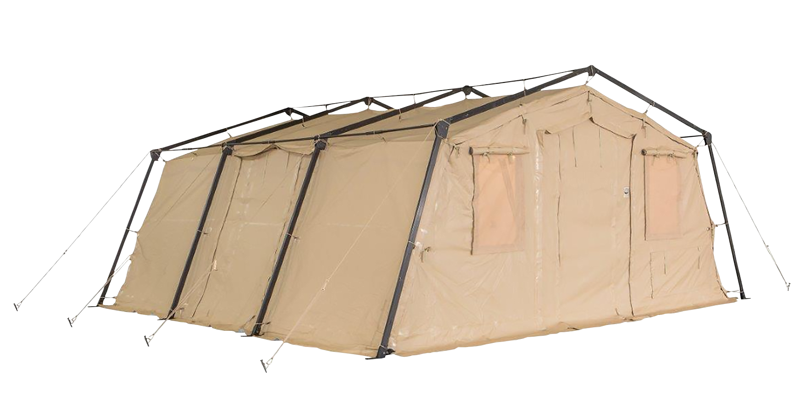
CAMSS20TAC Shelter System
A member of the 20TAC family of rapid deployment shelters
20’W x 20’L x 9’4” H
400 square feet of usable area
Assembles in 4 minutes with a trained four-person crew
Lightweight and durable
Rigorous military testing in extreme conditions
Simple one-piece frame
One-piece bundle
For more information on our CAMSS20TAC20, click
http://www.camss.com/product/camss-20tac20/

Slide 3
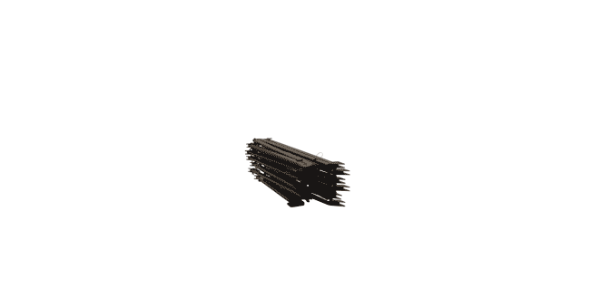
CAMSS20TAC20 Extreme Testing & Engineering
Designed to maintain internal temperatures of 40°F to 80°F in ambient temperature of -25°F to 125°F when supported by a 5-ton military environmental control unit
Meets Test Operations Procedure (TOP) 10-2-175 Tents and Shelters wind load test of similar type and size shelter
Engineering calculation demonstrate shelter performance will meet a 65 mph wind load per ASCE 7-16
Meets Test Operations Procedure (TOP) 10-2-175 Tents and Shelters 10 psf snow load test per testing of similar type TAC shelter

Slide 4
CAMSS20TAC20 Extreme Testing & Engineering
Meets test operations procedure (TOP) 10-2-175 tents and shelters 10 psf snow load per testing of similar type TAC shelter
Meets test operations procedure (TOP) 10-2-175 tents and shelters wind-driven rain test per testing of similar TAC shelter
Meets test operations procedure (TOP) 10-2-175 tents and shelters blackout test at 100m with naked eye and 300m with night vision goggles per testing of similar TAC shelter
40+ setup/strike and fully deployable per testing of similar type TAC shelter

Slide 5
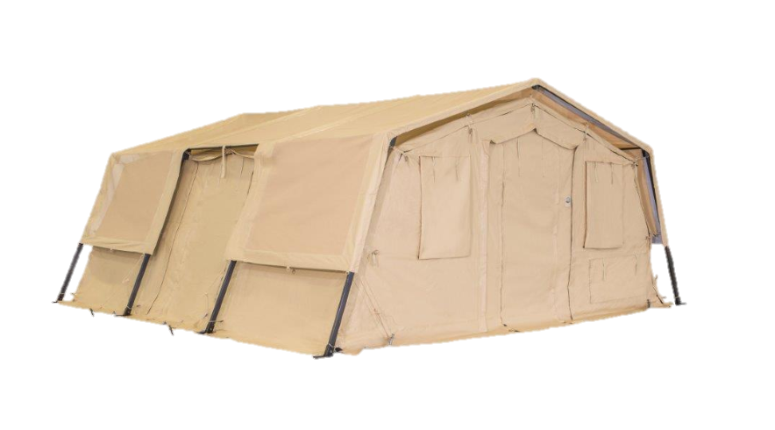
OPTIONAL: CAMSS20TAC20 Thermacam Fly
Significantly reduces heat from sun
Lightweight and compact
Fly, ropes, and spikes weigh 90 lbs.
Designed to install without any disassembly of the shelter
RF welded mil-spec fabric with mesh that meets fire rating ASTM D6413
Uses 20TAC20 shelter frame
Withstands 55 mph sustained winds with 65 mph wind gusts
Part Numbers
Tan Color – CAMSS-20TAC20-TSF-T
Green Color – CAMSS-20TAC20-TSF-G

Slide 6
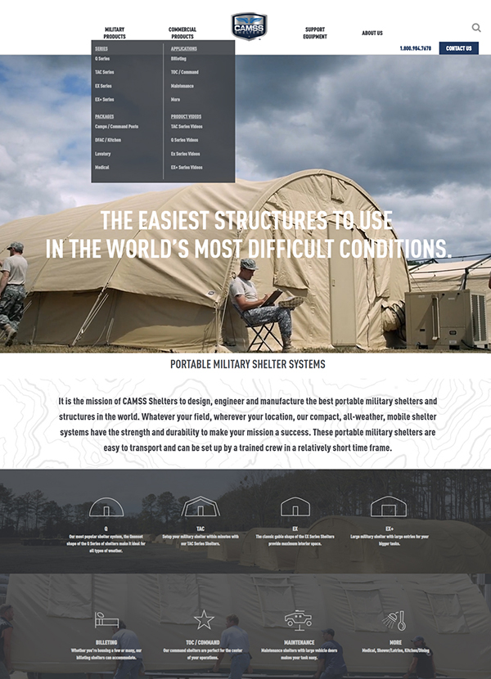
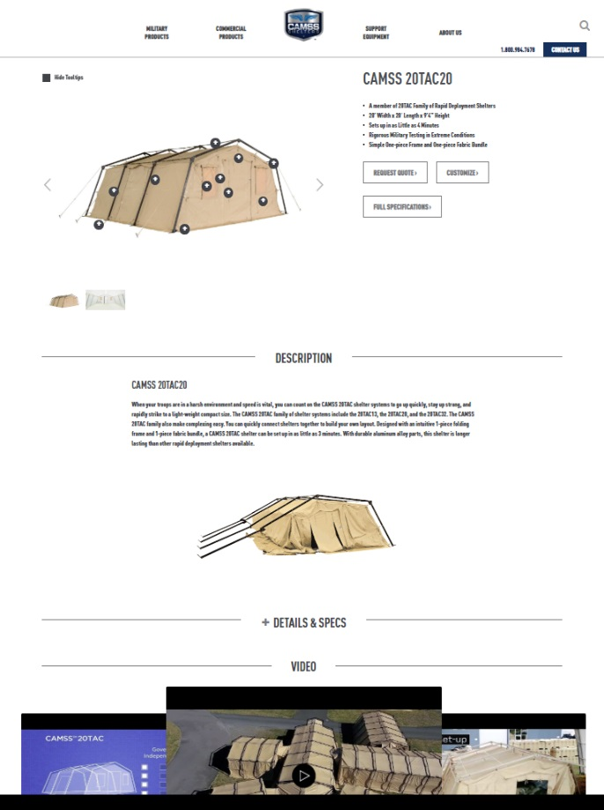
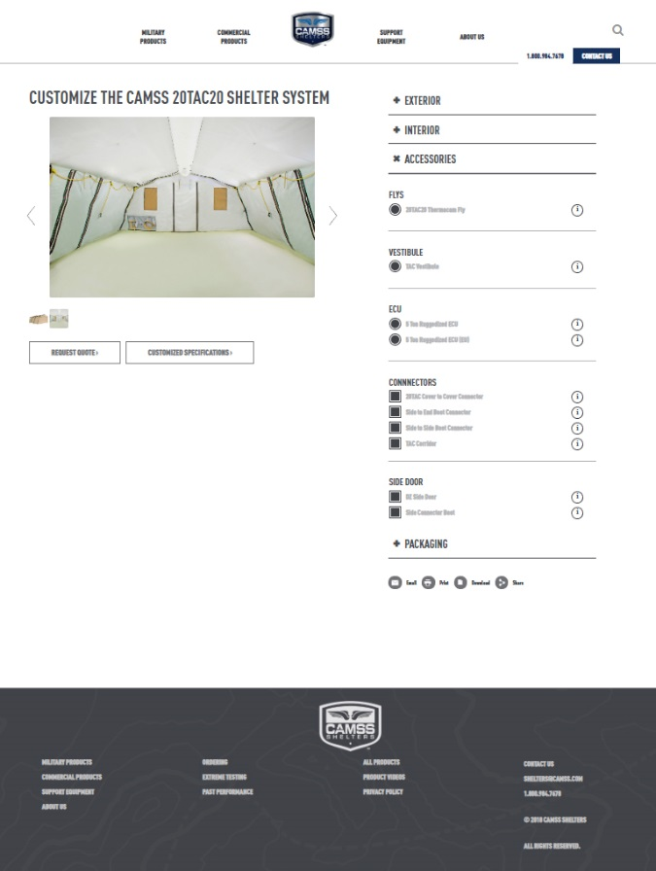
CAMSS Website
CAMSS.com
Product Page
Customize

Slide 7
Thank you for considering CAMSS Shelters
For further questions, please contact us below

