Slide 1
CAMSS30IS
Shelter System

Slide 2
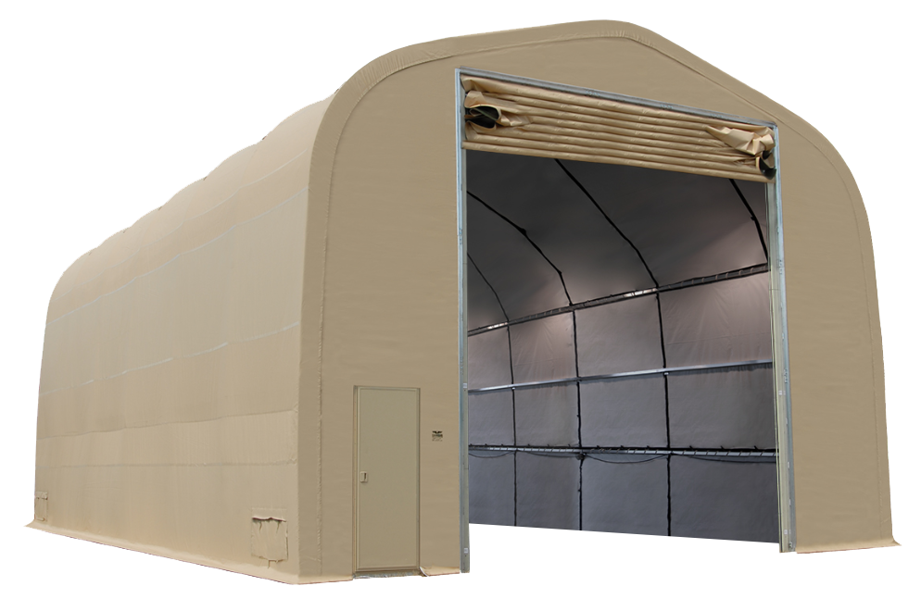
CAMSS30IS Shelter System
30’ W x 48’ L x 24’4” H with 18’6” eaves
1440 sq. ft. usable space
Vertical lift vehicle door – 16’ W x 16’11” H
Sets up in ten (10) hours with a trained crew of eight (8)
No heavy equipment required for setup
Used for maintenance, vehicle inspection or emergency response staging
Fire resistant per NFPA 701
For more information on our CAMSS30IS, click
www.camss.com/product/camss-30iseh48/

Slide 3
CAMSS30IS Engineering and Design
Designed to maintain internal temperature of 40°F to 80°F in ambient temperature of -25°F to 125°F when supported by military environmental control units
Engineering calculations demonstrate shelter performance meets a wind load of 100 mph per ASCE 7-16
Engineering calculations demonstrate shelter performance meets ground snow load of 20 psf per ASCE 7-16
For more information on our CAMSS30IS, click
www.camss.com/product/camss-30iseh48/

Slide 4
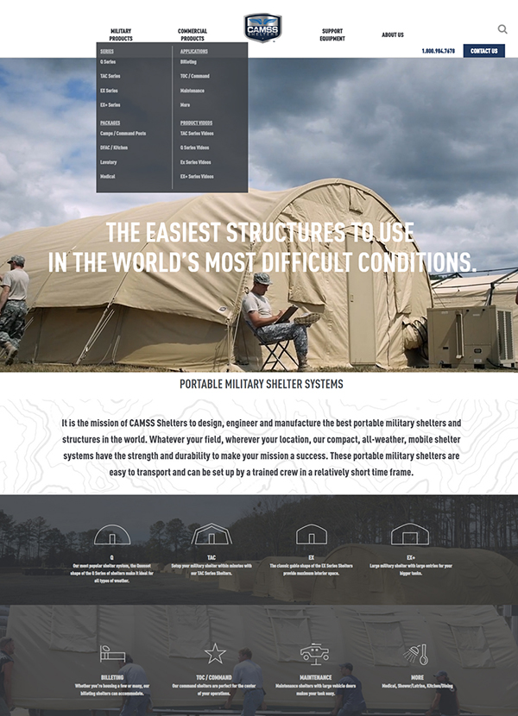
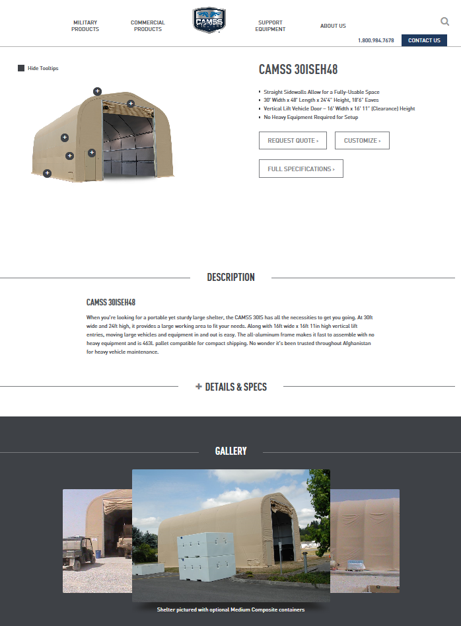
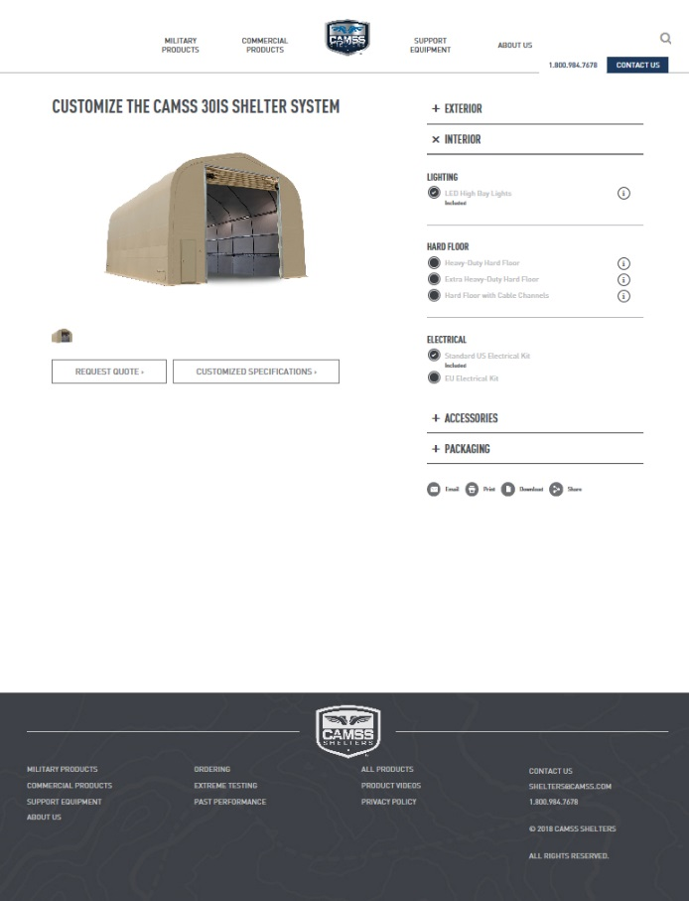
CAMSS Website
CAMSS.com
Product Page
Customize

Slide 5
Thank you for considering CAMSS Shelters
For further questions, please contact us below

