Slide 1
CAMSS35EXLP
Shelter System

Slide 2
CAMSS35EXLP Shelter System Video

Slide 3
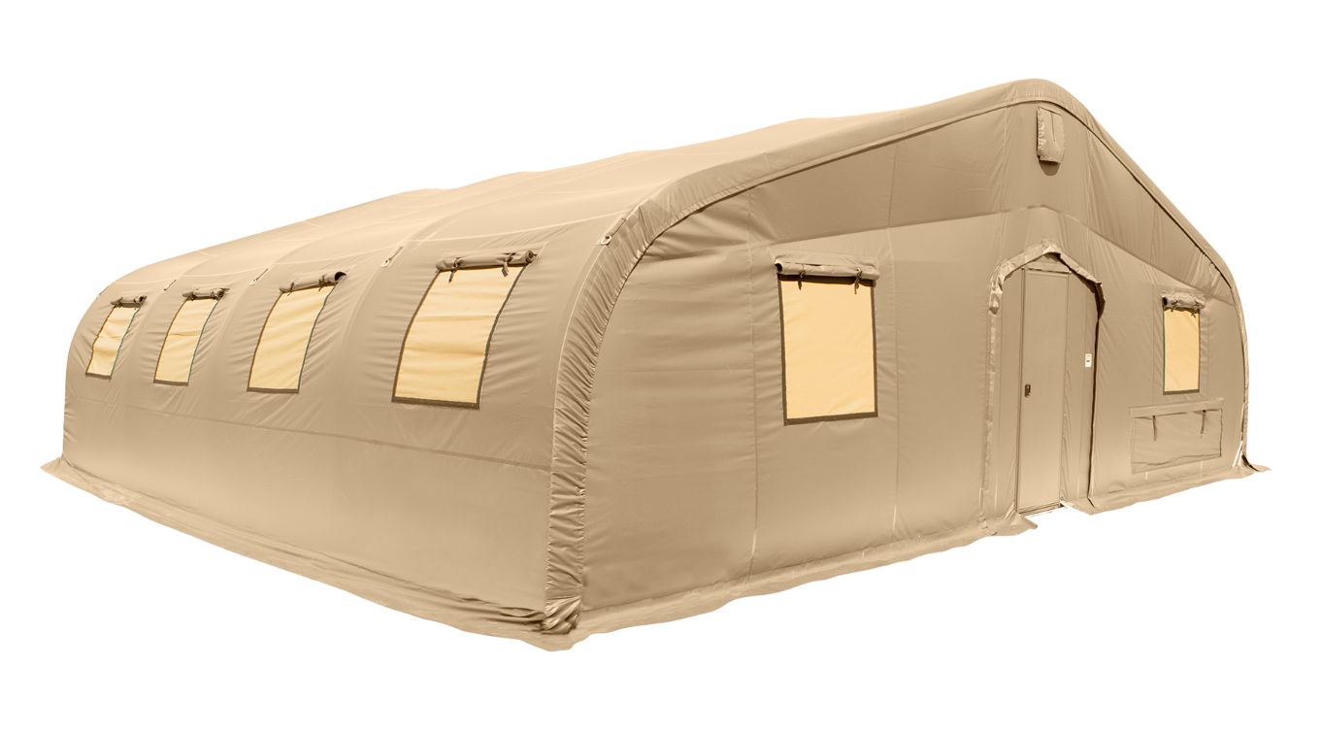
CAMSS35EXLP Shelter System
Straight sidewalls allow for a fully-usable space
35’ W x 32’ L x 12’8” H
1120 square feet of usable area
Assembles in 8 hours with a trained six-person crew
Used for billeting, command post, and/or recreation
For more information on our CAMSS35EXLP, click
www.camss.com/product/camss-35exlp/

Slide 4
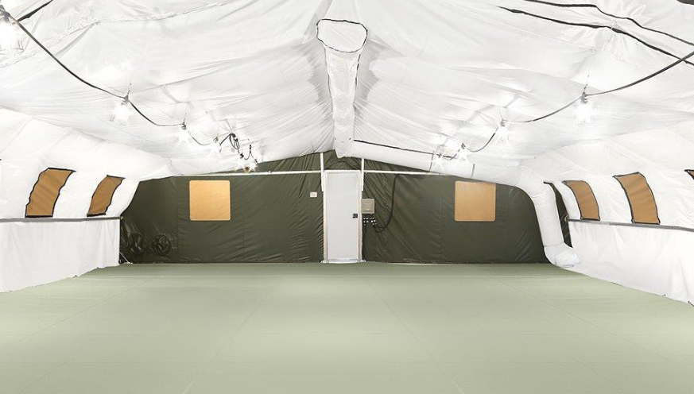
CAMSS35EXLP Engineering & Design
Designed to maintain internal temperature of 40°F to 80°F in ambient temperature of -25°F to 125°F when supported by 5-ton military environmental control units
Engineering calculations demonstrate shelter performance meets a 100 mph wind load per ASCE 7-16
Engineering calculations demonstrate shelter performance meets a ground snow load of 20 psf per ASCE 7-16

Slide 5
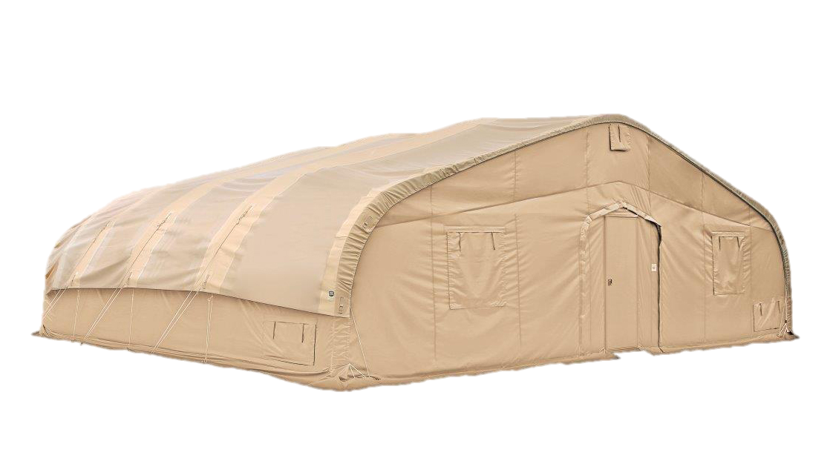
OPTIONAL: CAMSS35EXLP SolarFly
Significantly reduces heat from sun and ECU usage
Lightweight and compact
Fly, ropes, and spikes weigh 320 lbs.
Designed to install without any disassembly of the shelter
RF welded mil-spec fabric with mesh that meets fire rating ASTM D6413
Uses CAMSS35EXLP shelter frame
Withstands 55 mph sustained winds with 65 mph wind gusts
Part Numbers
Tan Color – CAMSS-35EX32-SF-T
Green Color – CAMSS-35EX32-SF-G

Slide 6
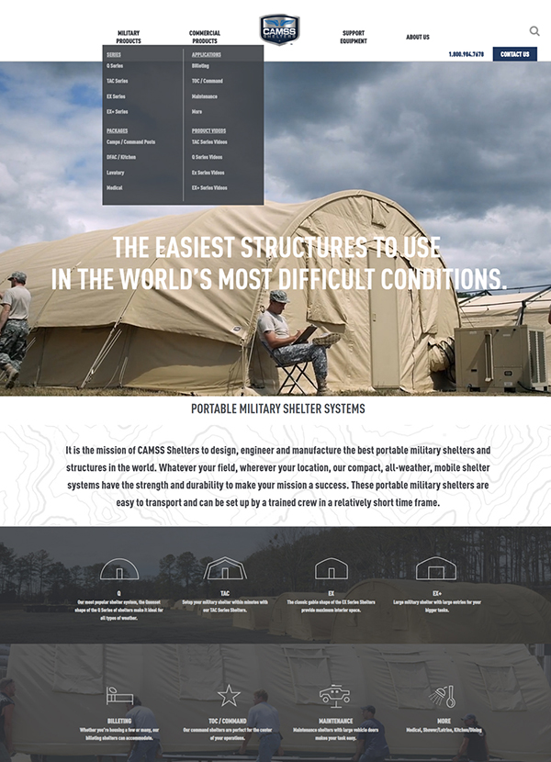
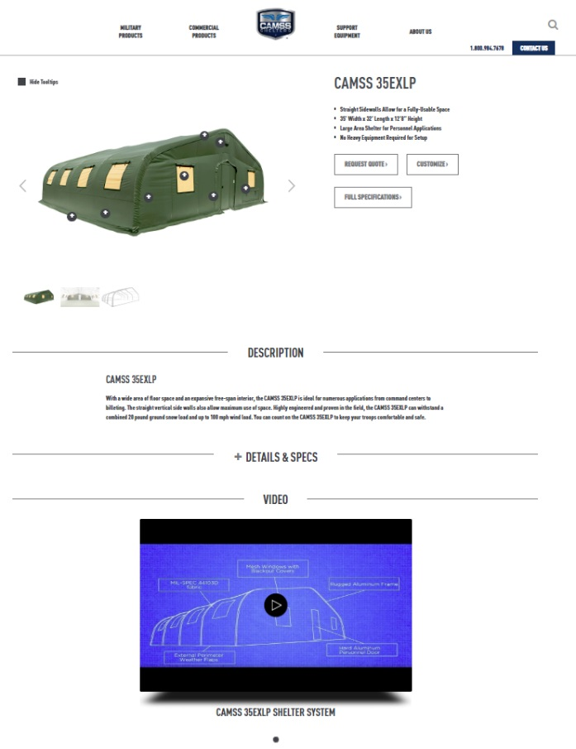
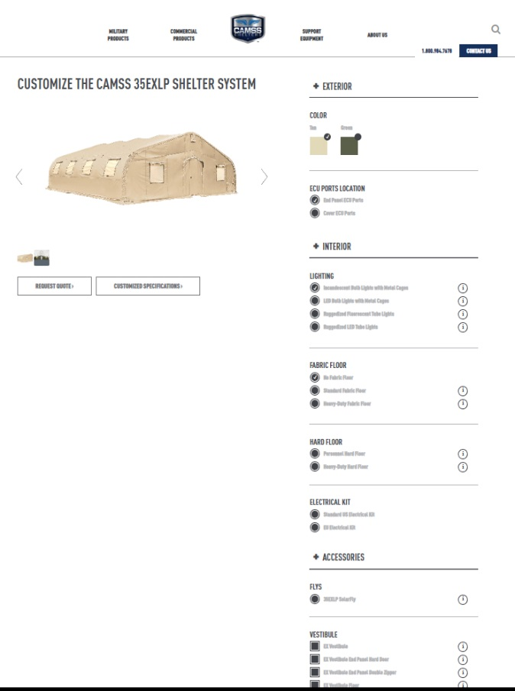
CAMSS Website
CAMSS.com
Product Page
Customize

Slide 7
Thank you for considering CAMSS Shelters
For further questions, please contact us below

