Slide 1
CAMSS18EX
Shelter System

Slide 2
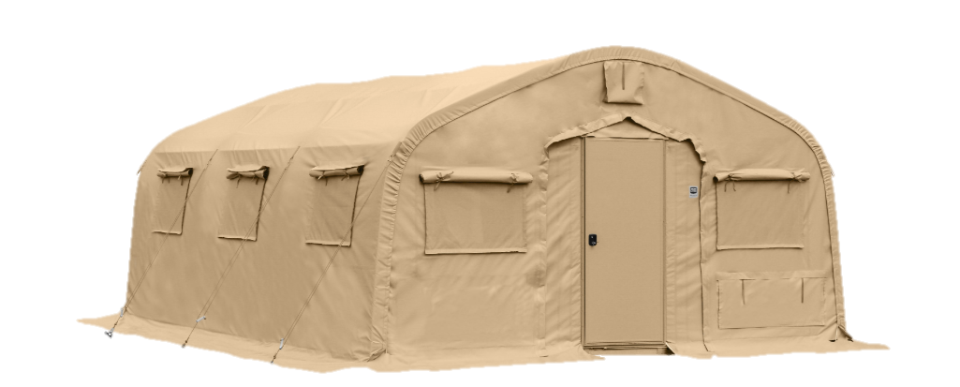
CAMSS18EX Shelter System
Straight sidewalls allow for a fully-usable space
18’W x 24’L x 10’H with 7’ eaves
Usable area of 432 square feet
855 lbs unpackaged
Assembles in 20 minutes with a trained four-person crew
Used for billeting, command post, or forward operating base
For more information on our CAMSS18EX, click
http://www.camss.com/product/camss-18ex/

Slide 3
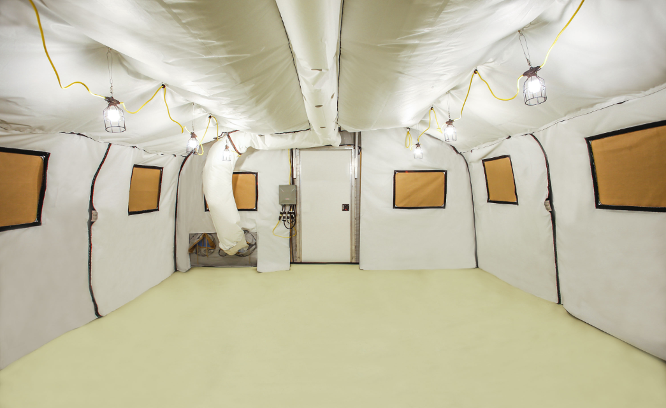
CAMSS18EX Engineering and Design
Designed to maintain internal temperatures of 40°F to 80°F in ambient temperatures of -25°F to 125°F with a 5-ton ECU
Engineered to withstand 100 mph wind load per ASCE 7-16
Engineered to withstand 15 psf ground snow load per ASCE 7-16
Designed for 20 set-up/strikes and fully deployable
For more information on our CAMSS18EX, click
http://www.camss.com/product/camss-18ex/

Slide 4
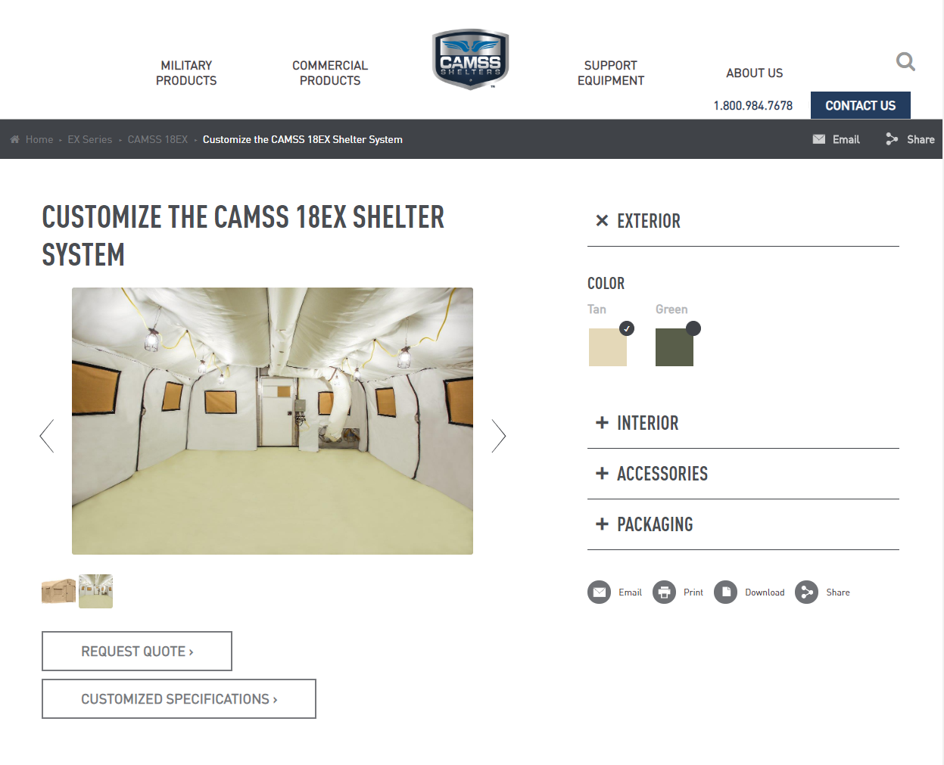
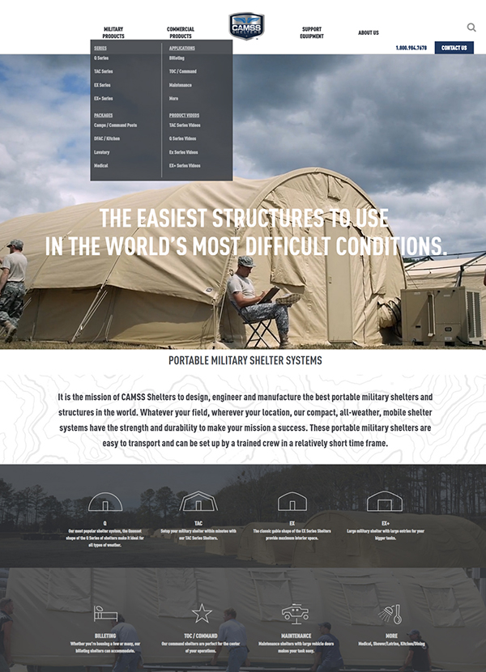
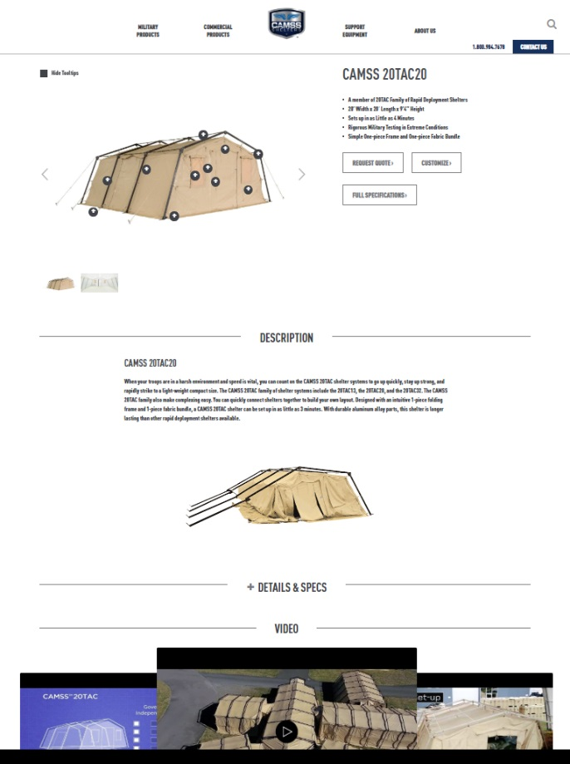
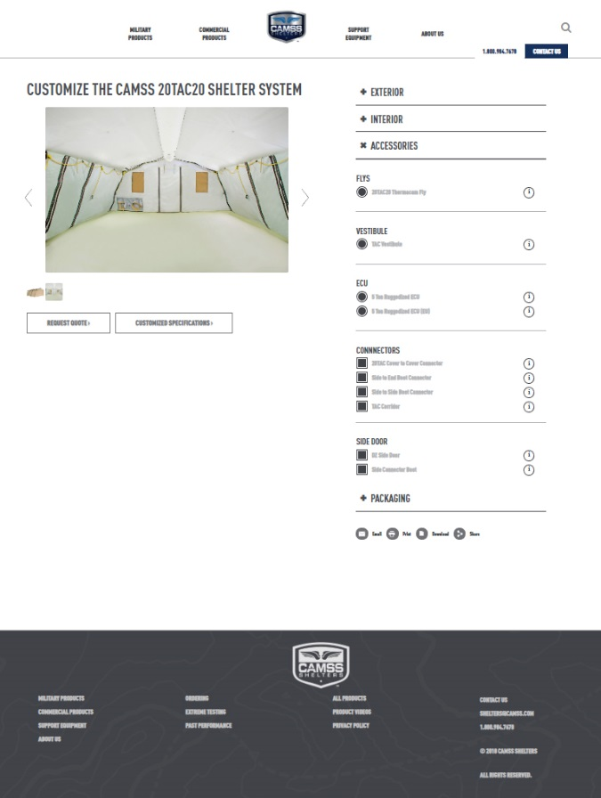
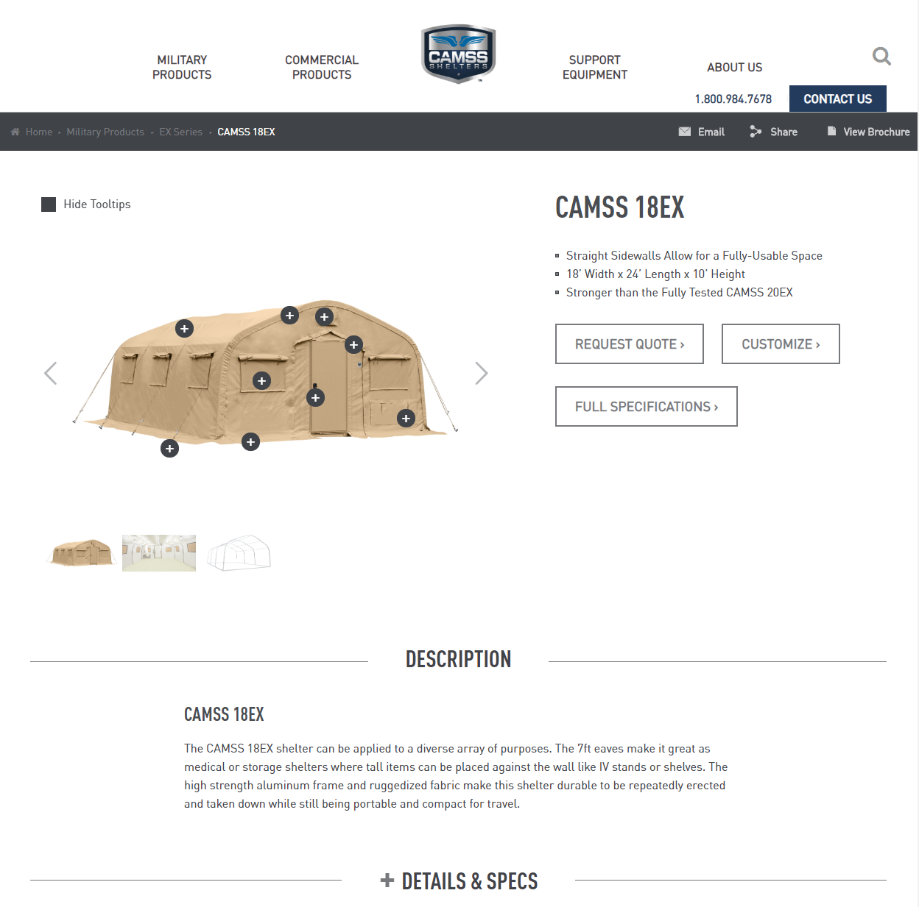
CAMSS Website
CAMSS.com
Product Page
Customize

Slide 5
Thank you for considering CAMSS Shelters
For further questions, please contact us below

