Slide 1
CAMSS24TACLME
Shelter System

Slide 2
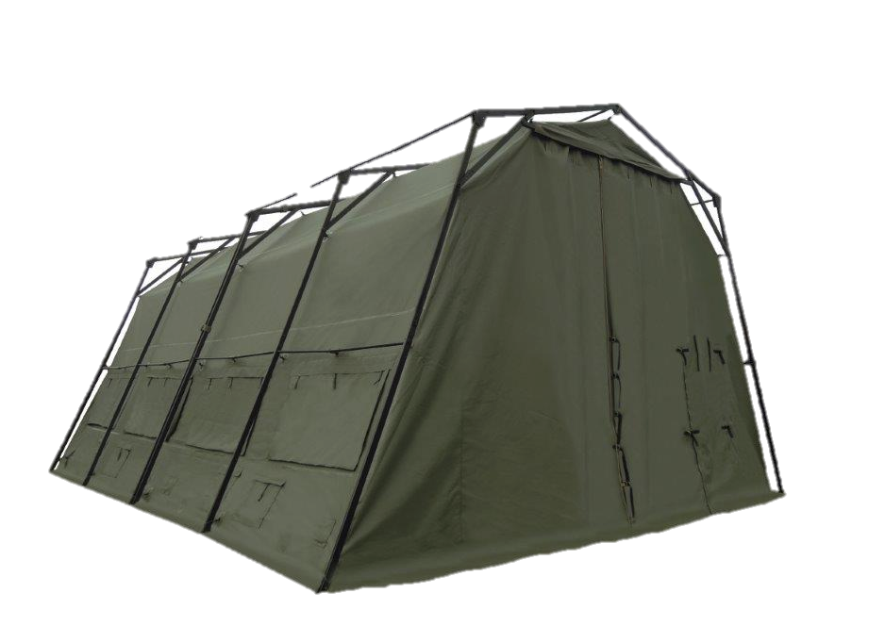
CAMSS24TACLME Shelter System
Lightweight Maintenance Enclosure (LME)
24’W x 32’6”L x 15’9” H, with 12’ lower eaves
780 square feet of usable area
1150 lbs. unpackaged
Folding frame for quick assembly and strike times
Assembles in under 25 minutes with a trained 4-person crew
Typically used for maintenance and rapid deployment situations
For more information on our CAMSS24TACLME, click
https://camss.com/product/camss-24tac-lme/

Slide 3
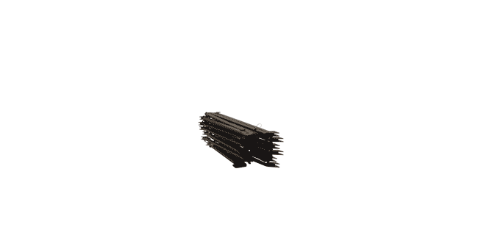
CAMSS24TACLME Extreme Testing & Engineering
Engineered to meet wind loads of 55 mph sustained winds with gusts up to 65 mph per ASCE 7-16
Engineered to meet ground snow loads of 10 psf per ASCE 7-16
Designed for 40+ set-up/strikes and fully deployable

Slide 4
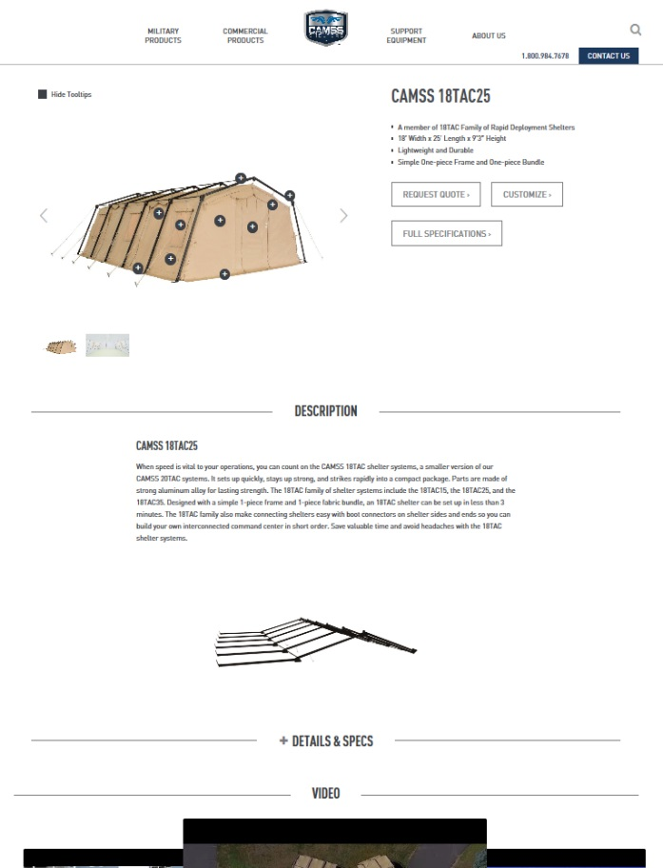
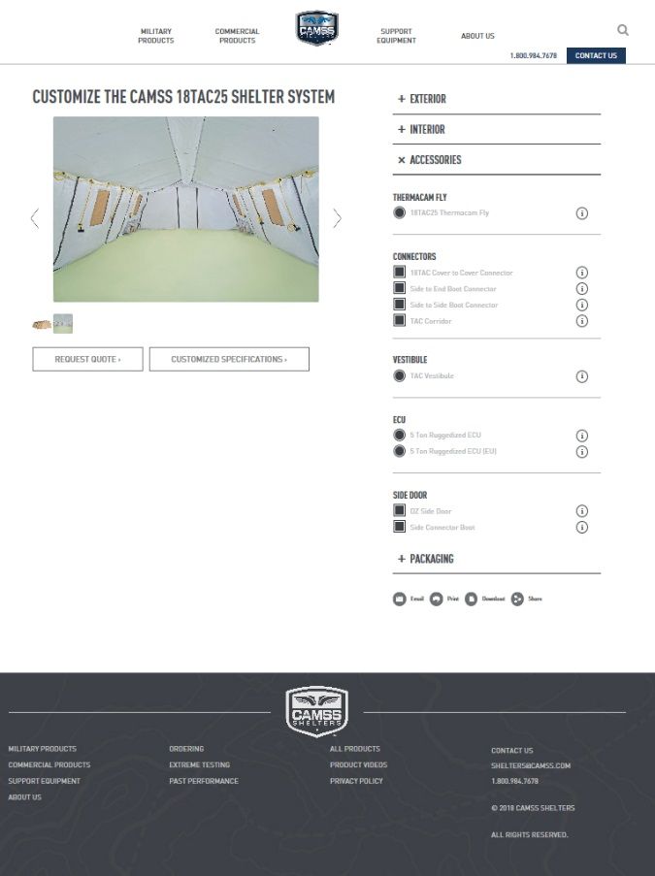
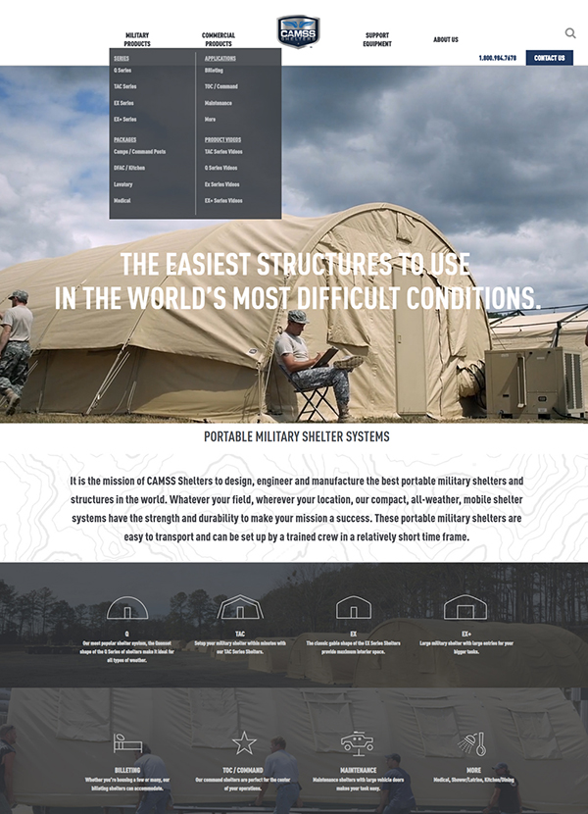
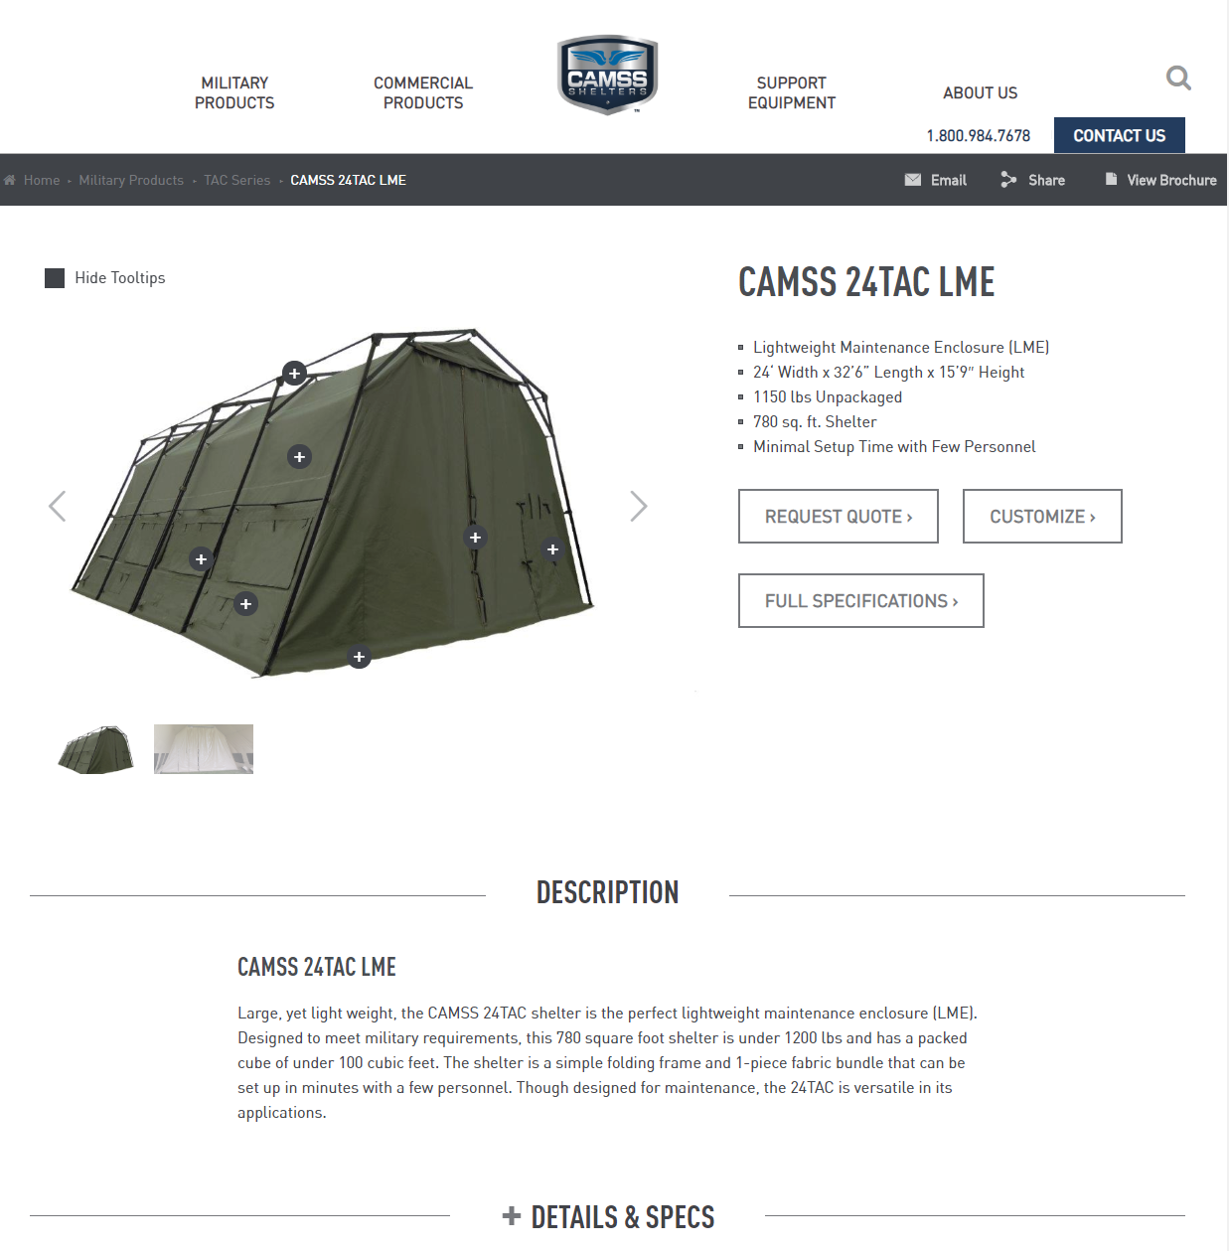
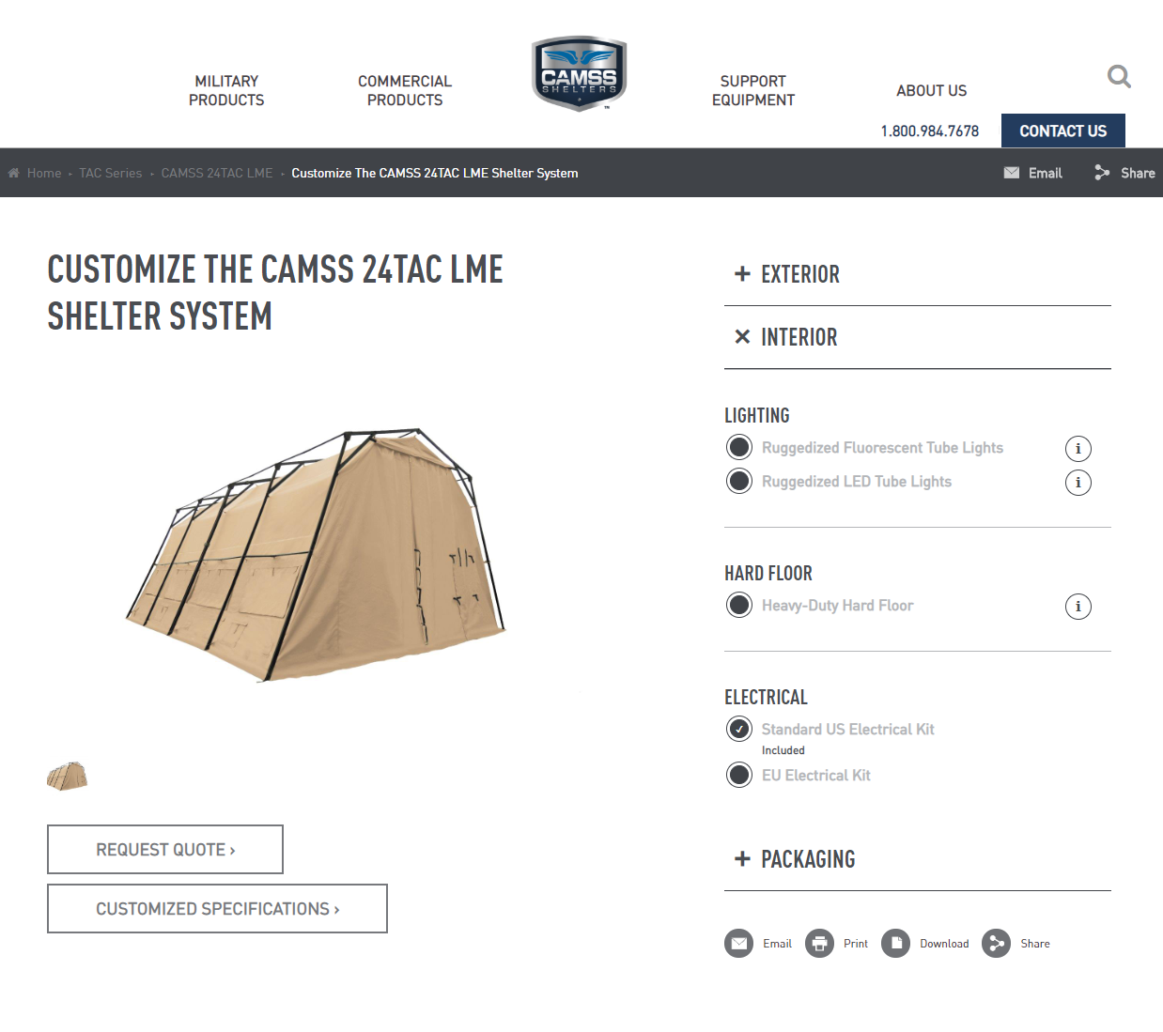
CAMSS Website
CAMSS.com
Product Page
Customize

Slide 5
Thank you for considering CAMSS Shelters
For further questions, please contact us below

