Slide 1
CAMSS14TAC32
Shelter System

Slide 2
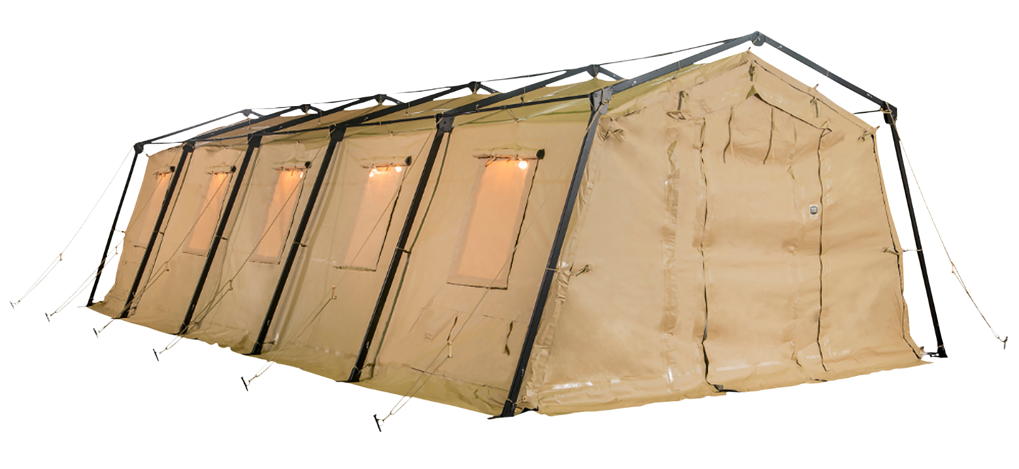
CAMSS14TAC32 Shelter System
Member of the 14TAC family of rapid deployment shelters
14’W x 32’ L x 9’3” H
448 square feet of interior space
Assembles in 6 minutes with a trained four-person crew
Lightweight and durable
Simple one-piece frame
One-piece bundle
Used for tactical operations centers (TOC), emergency response or disaster relief
For more information on our CAMSS14TAC32, click
www.camss.com/product/camss-14tac32/

Slide 3
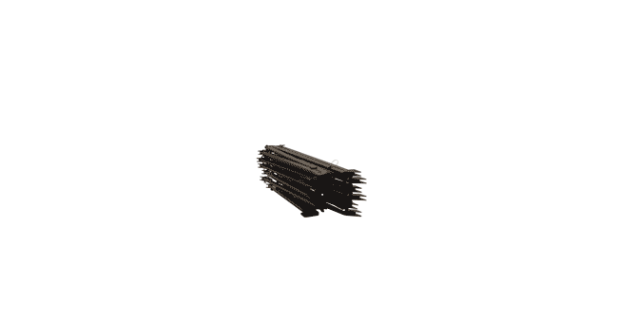
CAMSS14TAC32 Extreme Testing & Engineering
Designed to maintain internal temperatures of 40°F to 80°F in ambient temperature of -25°F to 125°F when supported by a 5-ton military environmental control unit
Meets Test Operations Procedure (TOP) 10-2-175 Tents and Shelters 55 mph wind and 65 mph gust per testing of similar type TAC shelter (NATC testing on CAMSS20TAC20)
Engineering calculation demonstrate shelter performance will meet a 65 mph wind load and 100 mph gusts per ASCE 7-16
Meets Test Operations Procedure (TOP) 10-2-175 Tents and Shelters 10 psf snow load testing similar type and size shelter (NATC testing on CAMSS20TAC20)

Slide 4
CAMSS14TAC32 Extreme Testing & Engineering
Meets test operations procedure (TOP) 10-2-175 tents and shelters wind-driven rain test per testing of similar TAC shelter (NATC testing on CAMSS20TAC20)
Meets test operations procedure (TOP) 10-2-175 tents and shelters blackout test at 100m with naked eye and 300m with night vision goggles per testing of similar TAC shelter (U.S. Army Aberdeen Test Center testing on CAMSS20TAC20)
40+ setup/strike and fully deployable per testing of similar type TAC shelter (U.S. Army Aberdeen Test Center and CAMSS testing on CAMSS20TAC20)

Slide 5
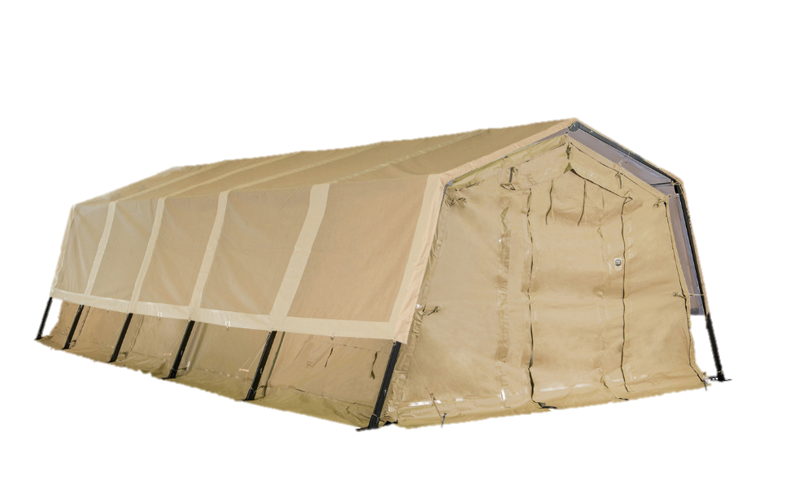
OPTIONAL: CAMSS14TAC32 Thermacam Fly
Significantly reduces heat from sun
Lightweight and compact
Fly, ropes, and spikes weigh 100 lbs.
Designed to install without any disassembly of the shelter
RF welded mil-spec fabric with mesh that meets fire rating ASTM D6413
Uses 14TAC32 shelter frame
Withstands 55 mph sustained winds with 65 mph wind gusts
Part Numbers
Tan Color – CAMSS-14TAC32-TC-T
Green Color – CAMSS-14TAC32-TC-G

Slide 6
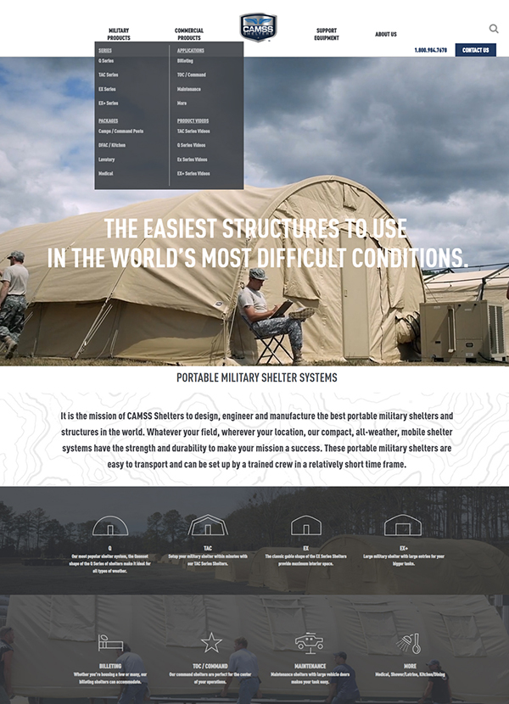
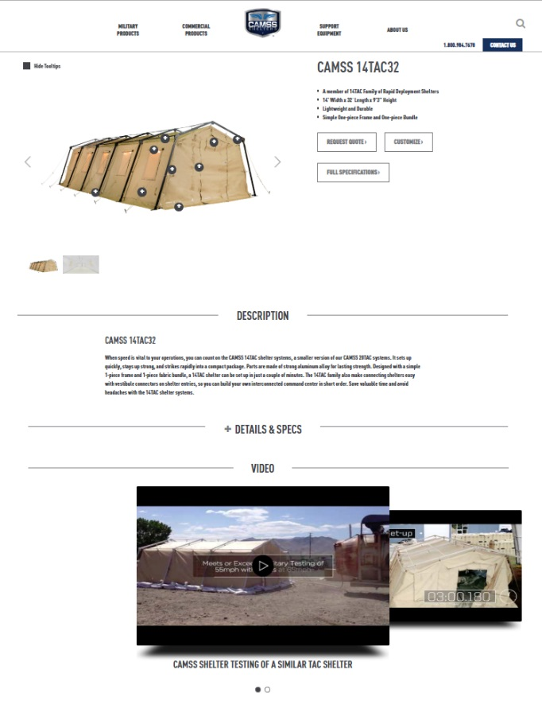
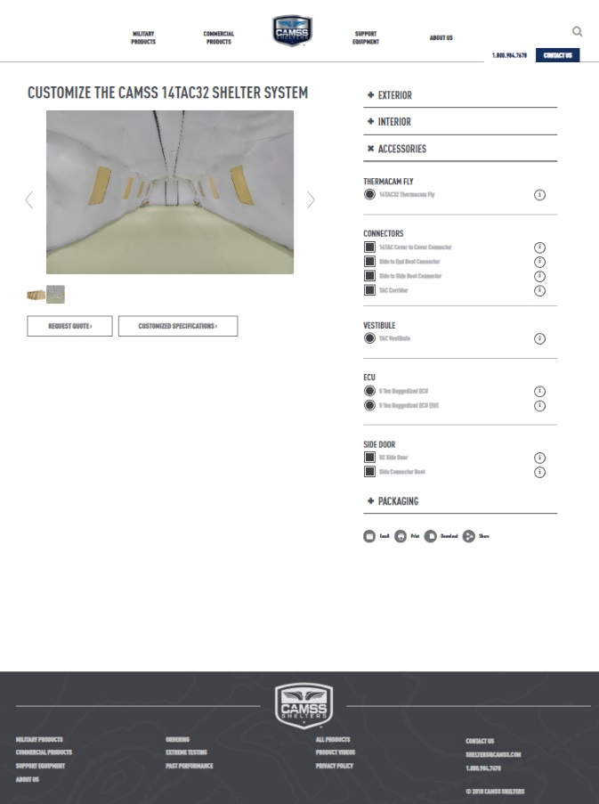
CAMSS Website
CAMSS.com
Product Page
Customize

Slide 7
Thank you for considering CAMSS Shelters
For further questions, please contact us below

