Slide 1
CAMSS18TAC15
Shelter System

Slide 2
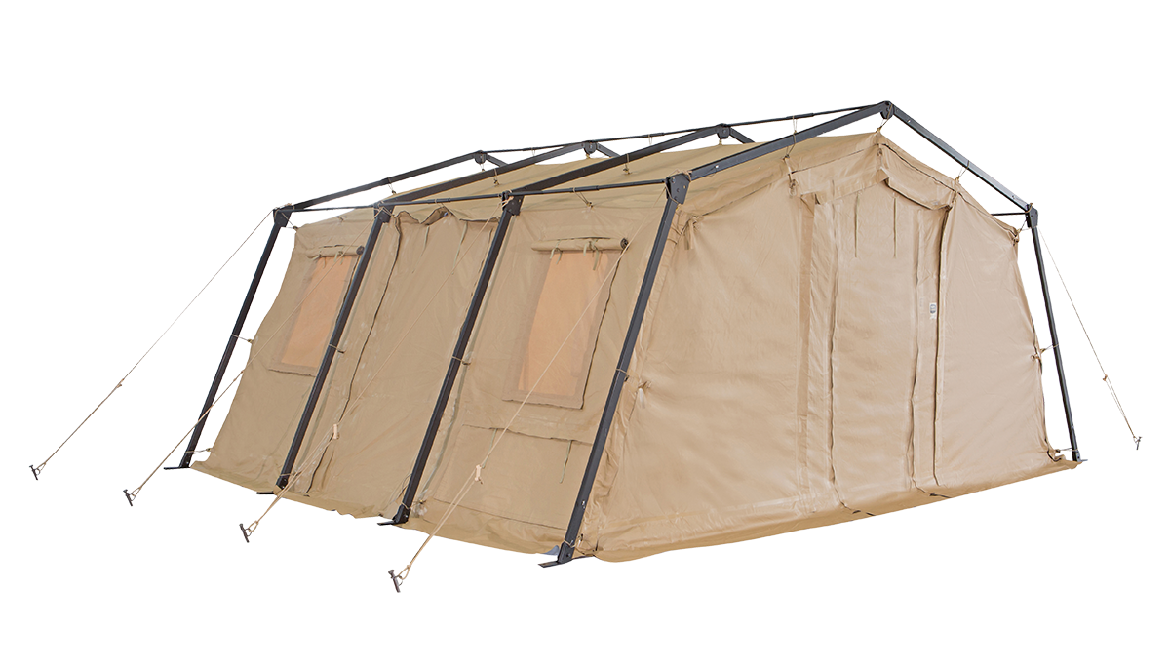
CAMSS18TAC15 Shelter System
A member of the 18TAC family of rapid deployment shelters
18’W x 15’L x 9’3” H
270 square feet of usable area
Assembles in 3 minutes with a trained four-person crew
Lightweight and durable
Simple one-piece frame
One-piece bundle
For more information on our CAMSS18TAC15, click
www.camss.com/product/camss-18tac15/

Slide 3
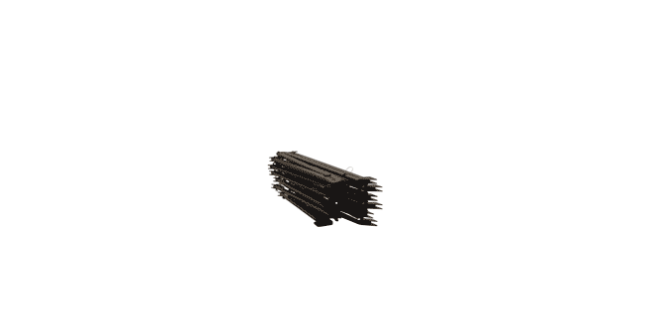
CAMSS18TAC15 Extreme Testing & Engineering
Designed to maintain internal temperatures of 40°F to 80°F in ambient temperature of -25°F to 125°F when supported by a 5-ton military environmental control unit
Meets Test Operations Procedure (TOP) 10-2-175 Tents and Shelters 55 mph sustained and 65 mph gusts wind load test of similar type and size shelter (NATC testing of CAMSS20TAC20)
Engineering calculations demonstrate shelter performance will meet a 65 mph wind load per ASCE 7-16

Slide 4
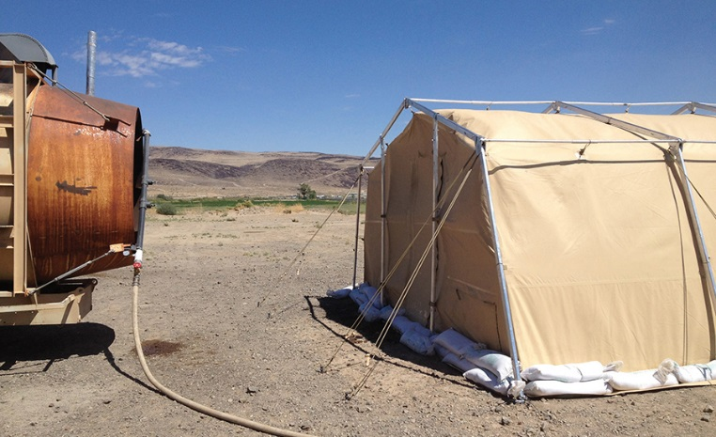
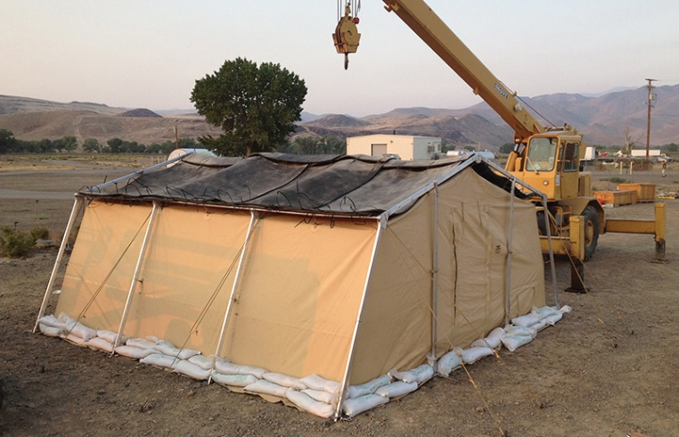
CAMSS18TAC15 Extreme Testing & Engineering
Meets Test Operations Procedure (TOP) 10-2-175 tents and shelters 10 psf snow load per testing of similar type TAC shelter (NATC testing on CAMSS20TAC20)
Meets Test Operations Procedure (TOP) 10-2-175 tents and shelters wind-driven rain test per testing of similar TAC shelter (NATC testing on CAMSS20TAC20)
Meets Test Operations Procedure (TOP) 10-2-175 tents and shelters blackout test at 100m with naked eye and 300m with night vision goggles per testing of similar TAC shelter (U.S. Army Aberdeen Test Center on CAMSS20TAC20)
40+ setup/strike and fully deployable per testing of similar type TAC shelter (U.S. Army Aberdeen Test Center and CAMSS testing on CAMSS20TAC20)

Slide 5
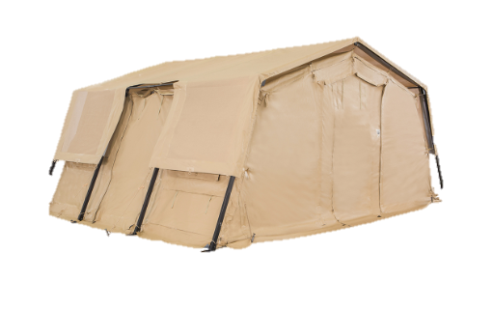
OPTIONAL: CAMSS18TAC15 Thermacam Fly
Significantly reduces heat from sun
Lightweight and compact
Fly, ropes, and spikes weigh 85 lbs.
Designed to install without any disassembly of the shelter
RF welded mil-spec fabric with mesh that meets fire rating ASTM D6413
Uses 18TAC15 shelter frame
Withstands 55 mph sustained winds with 65 mph wind gusts
Part Numbers
Tan Color – CAMSS-18TAC15-TC-T
Green Color – CAMSS-18TAC15-TC-G

Slide 6
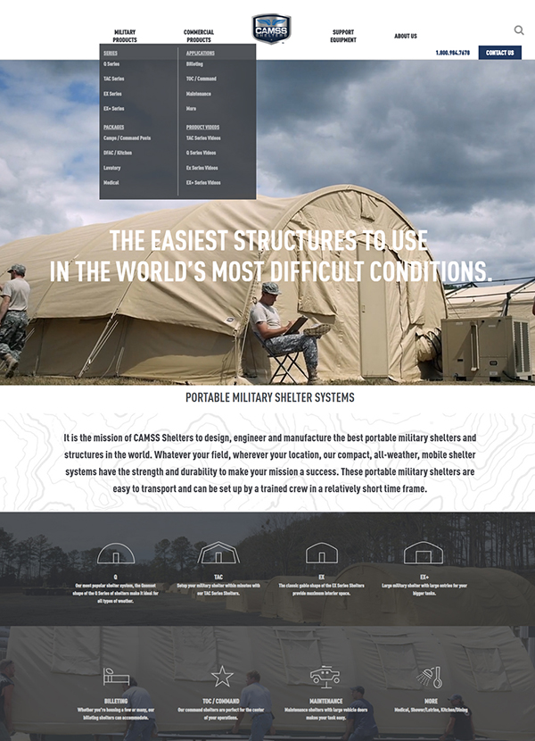
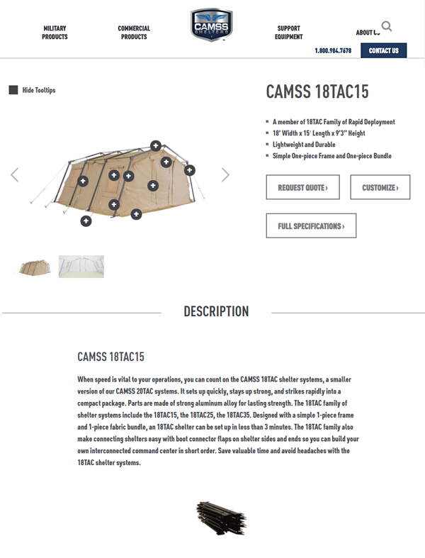
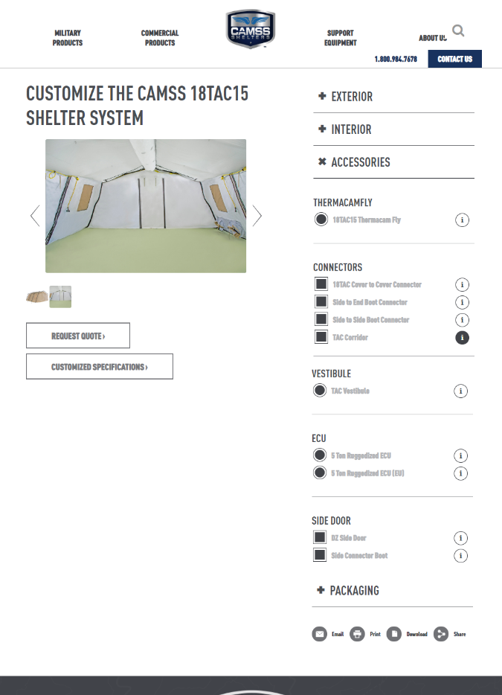
CAMSS Website
CAMSS.com
Product Page
Customize

Slide 7
Thank you for considering CAMSS Shelters
For further questions, please contact us below

