Slide 1
CAMSS20TAC13
Shelter System

Slide 2
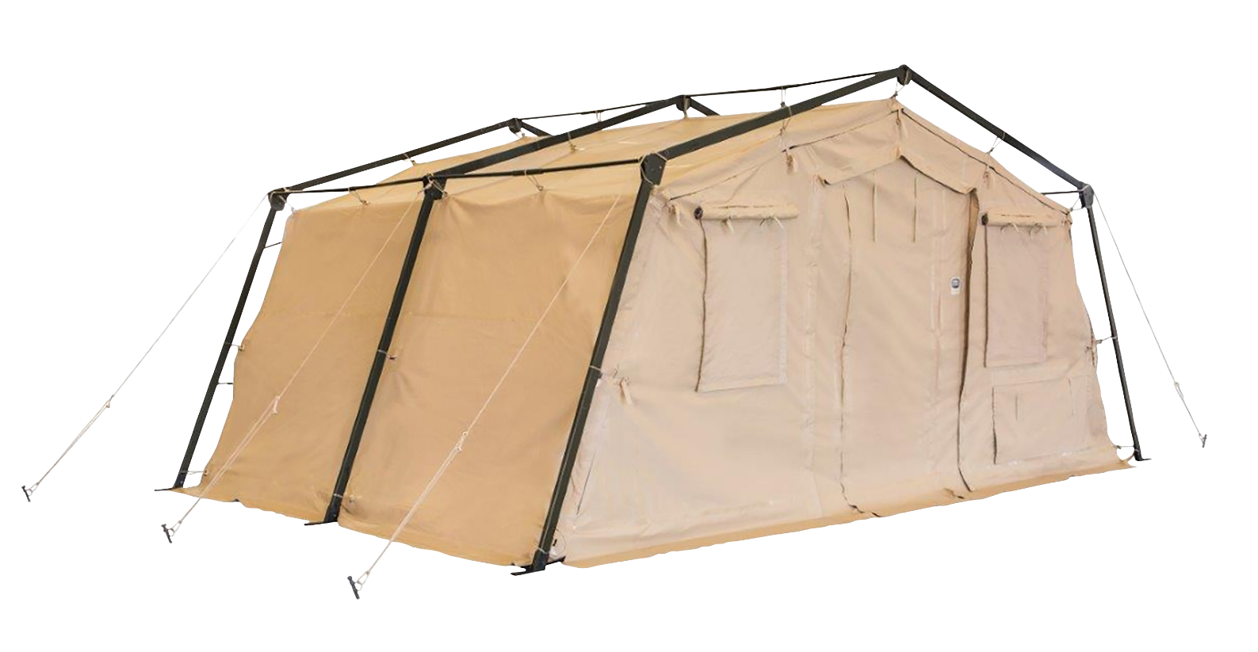
CAMSS20TAC13 Shelter System
A member of the 20TAC family of rapid deployment shelters
20’W x 13’L x 9’4” H
260 square feet of usable area
Assembles in under 3 minutes with a trained four-person crew
Lightweight and durable
Rigorous military testing in extreme conditions
Simple one-piece frame
One-piece bundle
For more information on our CAMSS20TAC13, click
http://www.camss.com/product/camss-20tac13/

Slide 3
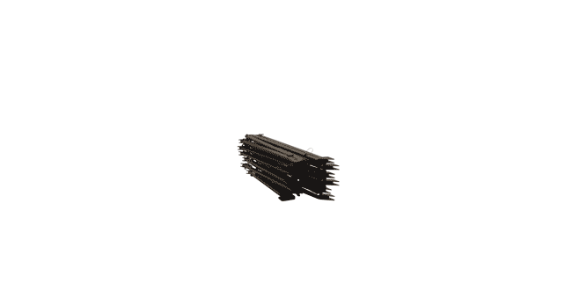
CAMSS20TAC13 Extreme Testing & Engineering
Designed to maintain internal temperatures of 40°F to 80°F in ambient temperature of -25°F to 125°F when supported by a 5-ton military environmental control unit
Meets Test Operations Procedure (TOP) 10-2-175 Tents and Shelters wind load test of similar type shelter (NATC testing of CAMSS20TAC20)
Engineering calculation demonstrate shelter performance will meet a 65 mph wind load per ASCE 7-16

Slide 4
CAMSS20TAC13 Extreme Testing & Engineering
Meets Test Operations Procedure (TOP) 10-2-175 tents and shelters 10 psf snow load per testing of similar type TAC shelter (NATC testing of CAMSS20TAC20)
Meets Test Operations Procedure (TOP) 10-2-175 tents and shelters wind-driven rain test per testing of similar TAC shelter (NATC testing of CAMSS20TAC20)
Meets Test Operations Procedure (TOP) 10-2-175 tents and shelters blackout test at 100m with naked eye and 300m with night vision goggles per testing of similar TAC shelter (U.S. Army Aberdeen Test Center testing on CAMSS20TAC20)
40+ setup/strike and fully deployable per testing of similar type TAC shelter (U.S. Army Aberdeen Test Center testing on CAMSS20TAC20)

Slide 5
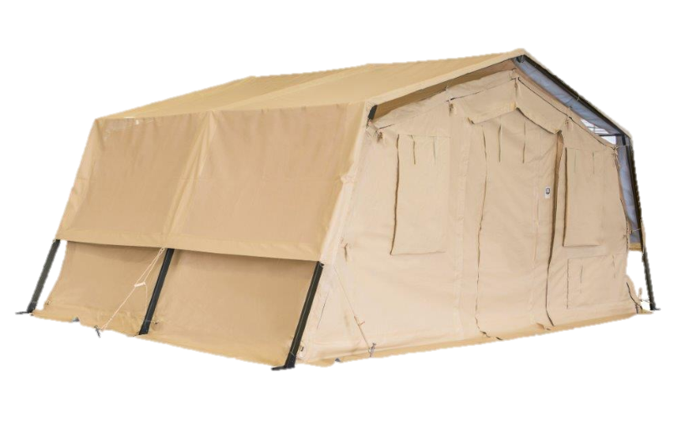
OPTIONAL: CAMSS20TAC13 Thermacam Fly
Significantly reduces heat from sun
Lightweight and compact
Fly, ropes, and spikes weigh 90 lbs.
Designed to install without any disassembly of the shelter
RF welded mil-spec fabric with mesh that meets fire rating ASTM D6413
Uses 20TAC13 shelter frame
Withstands 55 mph sustained winds with 65 mph wind gusts
Part Numbers
Tan Color – CAMSS-20TAC13-TSF-T
Green Color – CAMSS-20TAC13-TSF-G

Slide 6
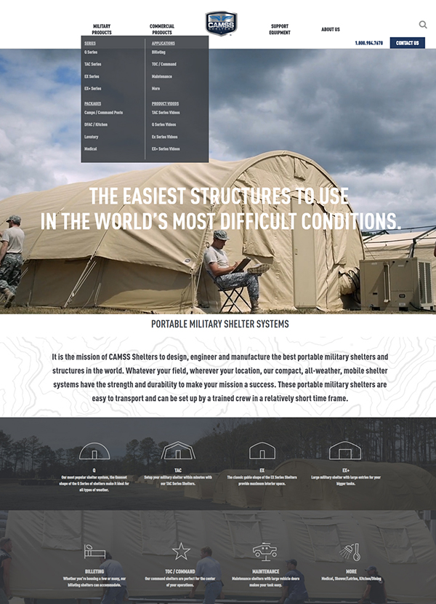
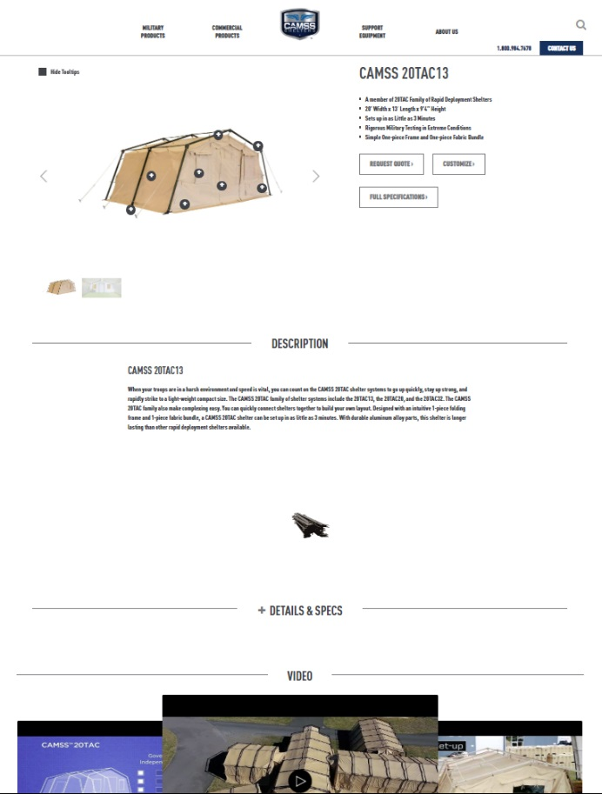
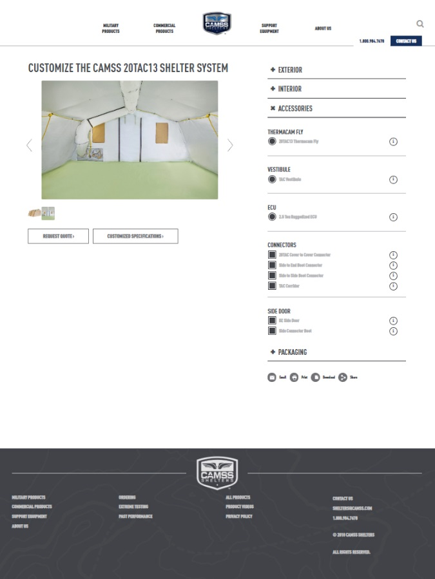
CAMSS Website
CAMSS.com
Product Page
Customize

Slide 7
Thank you for considering CAMSS Shelters
For further questions, please contact us below

