Slide 1
CAMSS40EX50SP
Shelter System

Slide 2
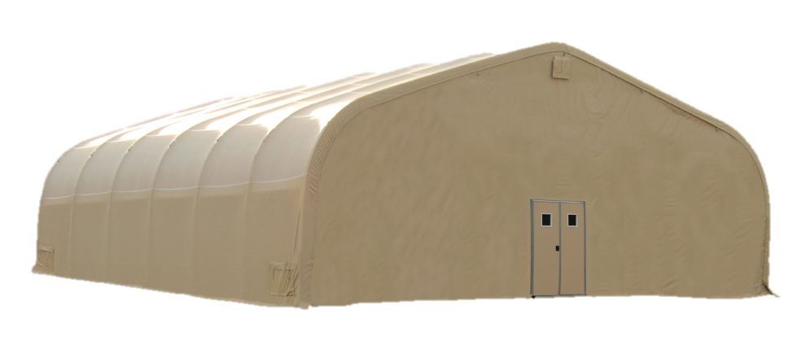
CAMSS40EX50SP Shelter System
40’ W x 50’ L x 16’ Peak H with 9’6” eaves
2000 sq. ft. usable space
Sets up in twelve (12) hours with a trained crew of eight (8)
No heavy equipment required for setup
Typical uses include recreation centers, dining, gyms and/or storage
One set personnel doors
One double zipper 8 ft W x 6 ft H
Fire resistant per NFPA 701
Engineered to withstand winds of 100 mph and ground snow load of 20 psf
For more information on our CAMSS40EX50SP, click
www.camss.com/product/camss-40ex50sp/

Slide 3
CAMSS40EX50SP Engineering & Design
Designed to maintain internal temperature of 40°F to 80°F in ambient temperature of -25°F to 125°F when supported by military environmental control units
Engineering calculations demonstrate shelter performance meets a wind load of 100 mph per ASCE 7-16
Engineering calculations demonstrate a shelter performance meets a ground snow load of 20 psf per ASCE 7-16
Shelter is capable of being erected in 12 hours with 8 personnel with no heavy equipment

Slide 4
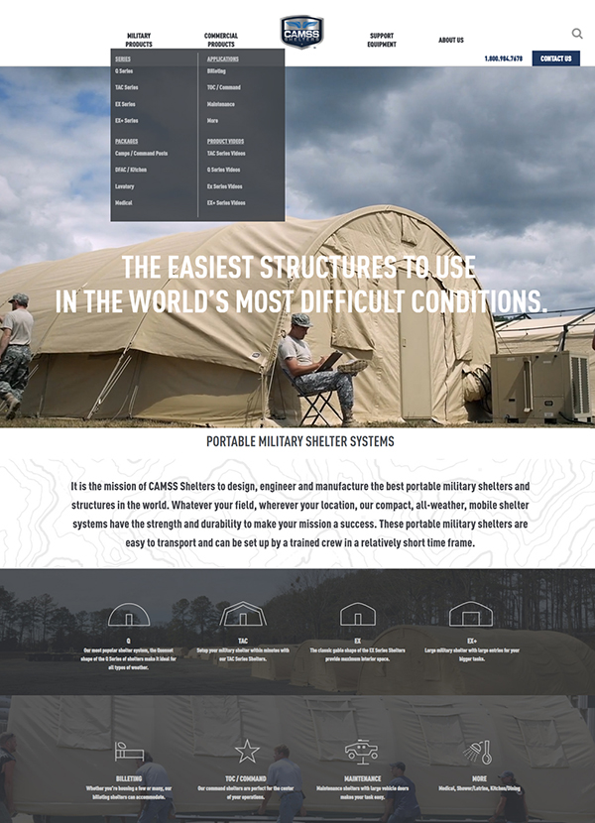
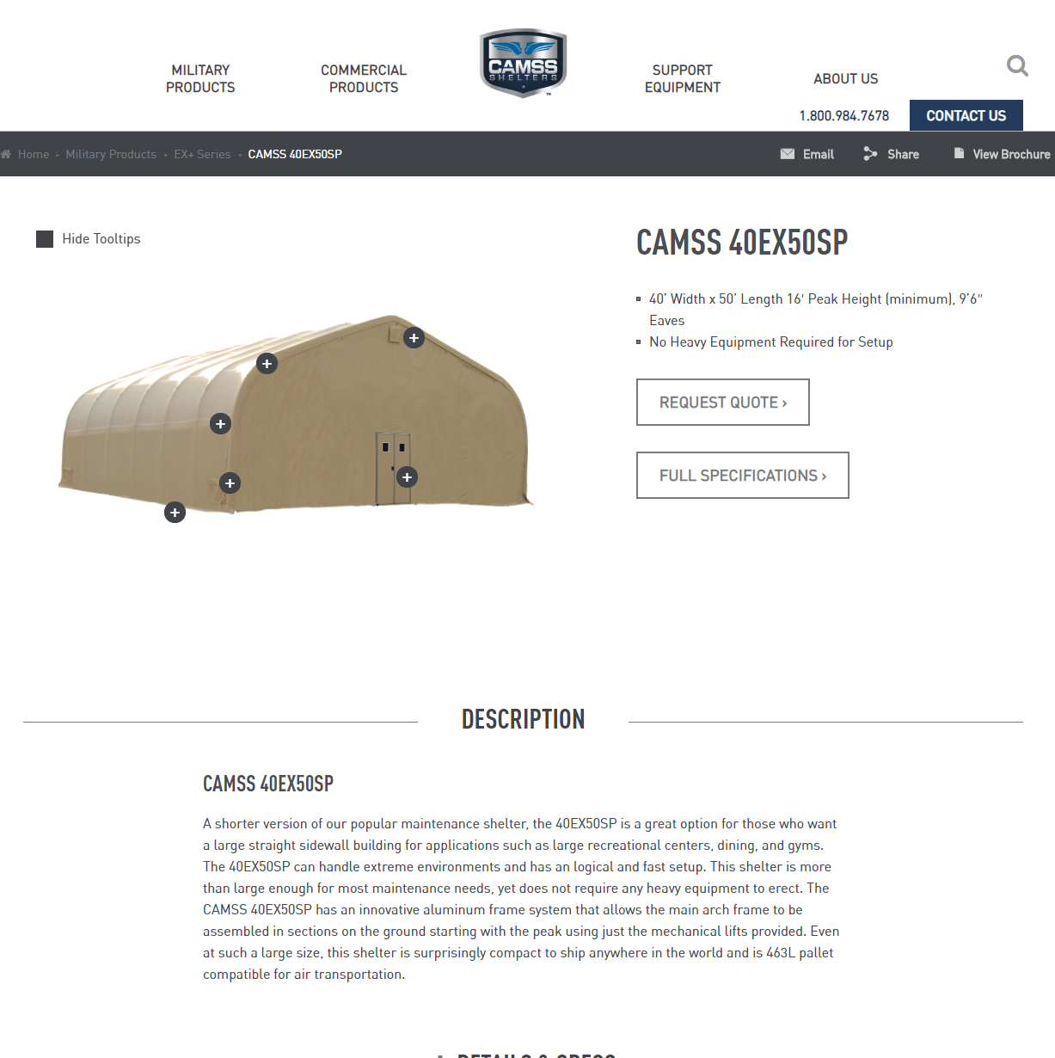
CAMSS Website
CAMSS.com
Product Page

Slide 5
Thank you for considering CAMSS Shelters
For further questions, please contact us below

