Slide 1
CAMSS EX+ Series
Military Vehicle Maintenance & Storage Shelters

Slide 2
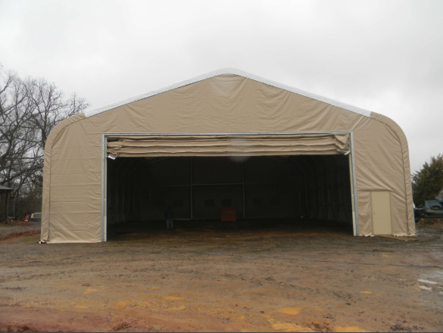
CAMSS Family of EX+ Shelter Systems
Our largest maintenance shelters series
Frequently used to house larger vehicles and equipment that require storage or repair
Used as military vehicle maintenance and storage shelters
Massive doors with tall clearances that allows larger vehicles to enter them easily
CAMSS 60EX
For more information on our EX+ shelters, click
https://camss.com/series/ex-plus/

Slide 3
CAMSS EX+ Series Links
CAMSS 28EX
CAMSS 30IS
28’W x 38’ L x 17’7” H, 12’ Eaves
Part Number (Tan): CAMSS-28EX38LP-T
Part Number (Green): CAMSS-28EX38LP-G
30’ W x 48’ L x 24’4” H, 18’6” Eaves
Part Number (Tan): CAMSS-30ISEH48-T
Part Number (Green): CAMSS-30ISEH48-G
CAMSS 35EXLP
40’W x 50’ L x 16’ Peak Height, 9’6” Eaves
Part Number (Tan): CAMSS-40EX50SP-T
Part Number (Green): CAMSS-40EX50SP-G

Slide 4
CAMSS EX+ Series Links
CAMSS 40EX58
CAMSS 40EX50LP
40’W x 58’ L x 25’3” Height, 18’ Eaves
Part Number (Tan): CAMSS-HIT-40EX5815T
Part Number (Green): CAMSS-HIT-40EX5815G
40’W x 50’ L x 20’ Peak Height, 13’ Eaves
Part Number (Tan): CAMSS-40EX50LP-T
Part Number (Green): CAMSS-40EX50LP-G
CAMSS 40EX50SP
40’W x 50’ L x 16’ Peak Height, 9’6” Eaves
Part Number (Tan): CAMSS-40EX50SP-T
Part Number (Green): CAMSS-40EX50SP-G

Slide 5
CAMSS EX+ Series Links
CAMSS 47EX
CAMSS 60EX
47’ W x 60’ L x 22’10” H, 14’ Eaves
Part Number (Tan): CAMSS47EX60-T
Part Number (Green): CAMSS47EX60-G
60’ W x 100’ L x 28’ H, 17’10” Eaves
Part Number (Tan): CAMSS-40EX50LP-T
Part Number (Green): CAMSS-40EX50LP-G
CAMSS 47EHEH90
47’ W x 90’ L x 27’5” H, 19’11” Eaves
Part Number (Tan): CAMSS47EXEH90-T
Part Number (Green): CAMSS47EXEH90-G

Slide 6
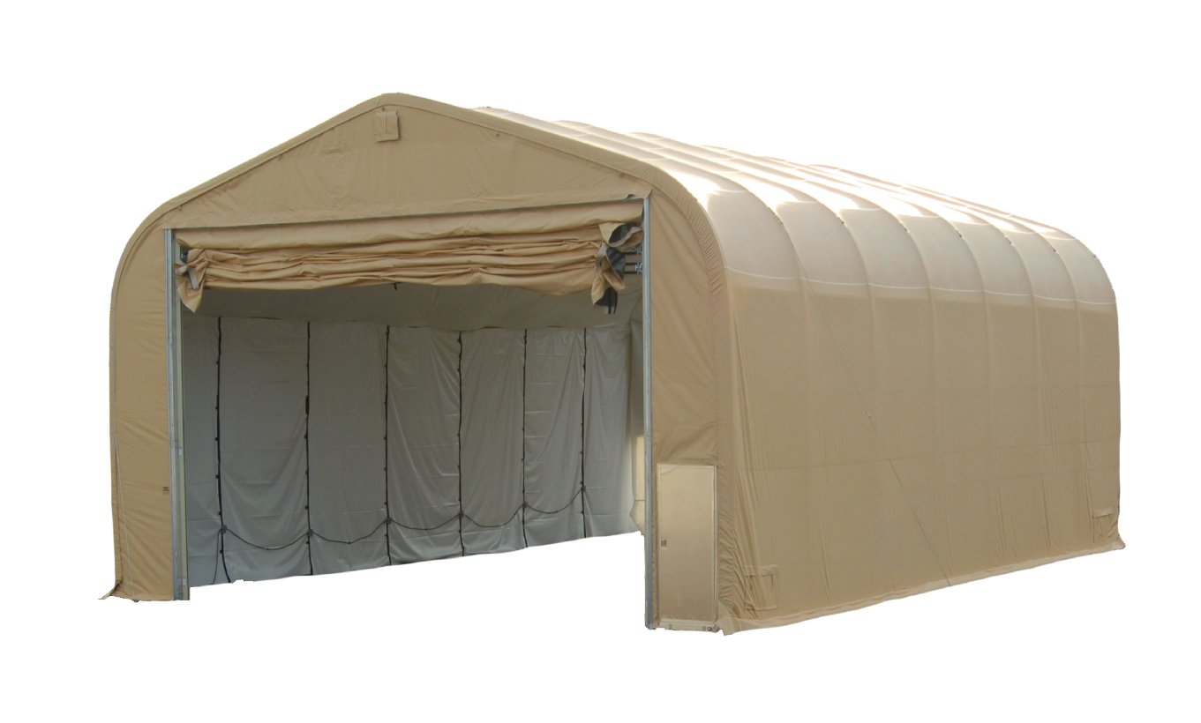
CAMSS40EX58 Shelter System
40’ W x 58’ L x 25’3” H with 18’ eaves
2320 sq. ft. usable space
Sets up in twenty (20) hours with a trained crew of eight (8)
No heavy equipment required for setup
Vertical lift vehicle doors – 30’ W x 15’ H
Typical uses include maintenance, warehouse and/or equipment storage
Fire resistant per NFPA 701
Engineered to withstand winds of 100 mph and ground snow load of 20 psf
For more information on our CAMSS40EX58, click
www.camss.com/product/camss-40ex/

Slide 7
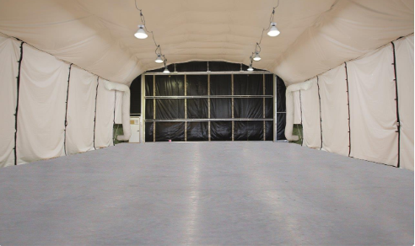
CAMSS40EX58 Engineering & Design
Designed to maintain internal temperature of 40°F to 80°F in ambient temperature of -25°F to 125°F when supported by military environmental control units
Engineering calculations demonstrate shelter performance meets a wind load of 100 mph per ASCE 7-16
For more information on our CAMSS40EX58, click
www.camss.com/product/camss-40ex/

Slide 8
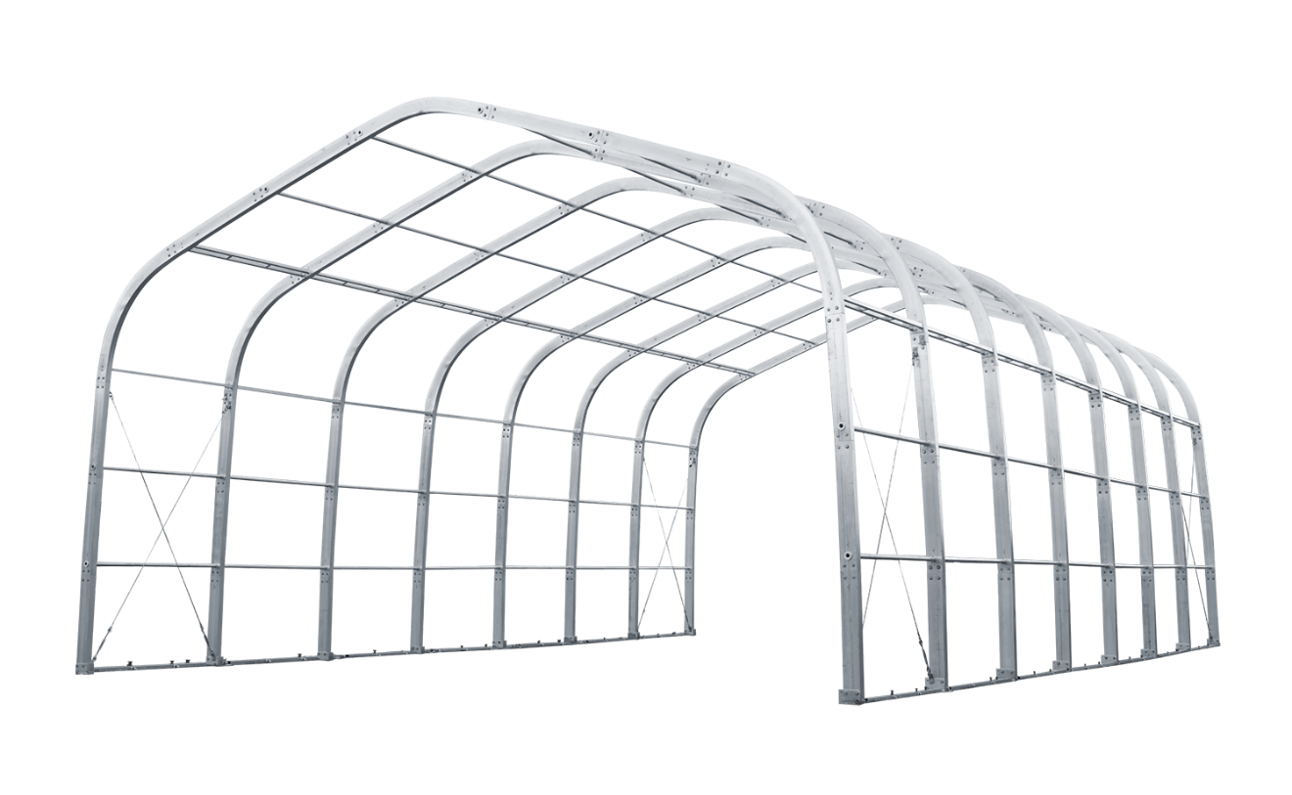
CAMSS40EX58 Engineering & Design
Engineering calculations demonstrate shelter performance meets a ground snow load of 20 psf per ASCE 7-16
Shelter is capable of being erected in 20 hours with 8 personnel with no heavy machinery
Vertical lift maintenance door shall open or close in 75 seconds
For more information on our CAMSS40EX58, click
www.camss.com/product/camss-40ex/

Slide 9
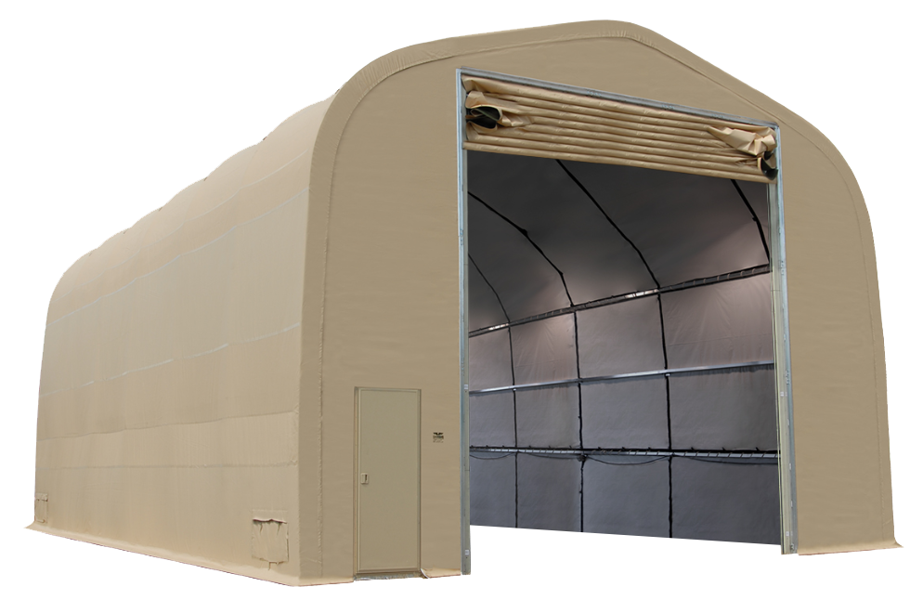
CAMSS30IS Shelter System
30’ W x 48’ L x 24’4” H with 18’6” eaves
1440 sq. ft. usable space
Vertical lift vehicle door – 16’ W x 16’11” H
Sets up in ten (10) hours with a trained crew of eight (8)
No heavy equipment required for setup
Used for maintenance, vehicle inspection or emergency response staging
Fire resistant per NFPA 701
For more information on our CAMSS30IS, click
www.camss.com/product/camss-30iseh48/

Slide 10
CAMSS30IS Engineering and Design
Designed to maintain internal temperature of 40°F to 80°F in ambient temperature of -25°F to 125°F when supported by military environmental control units
Engineering calculations demonstrate shelter performance meets a wind load of 100 mph per ASCE 7-16
Engineering calculations demonstrate shelter performance meets ground snow load of 20 psf per ASCE 7-16
For more information on our CAMSS30IS, click
www.camss.com/product/camss-30iseh48/

Slide 11
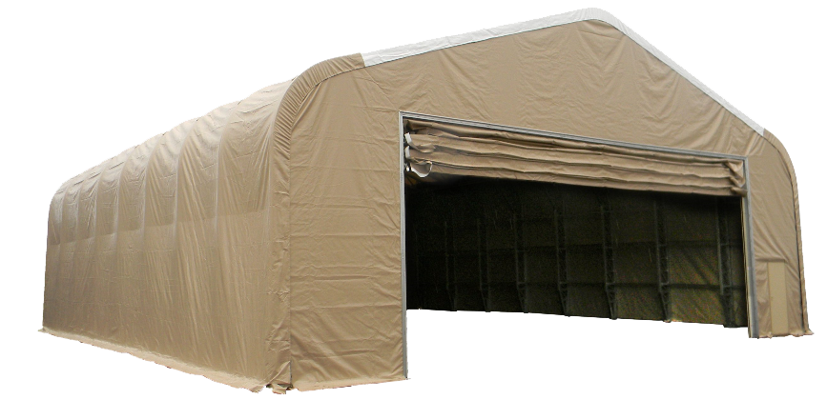
CAMSS60EX Shelter System
60’ W x 100’ L x 28’ H with 17’10” eave
6000 sq. ft. usable space
Assembles in thirty-two (32) hours with a trained crew of eight (8)
Used for maintenance, warehouse and/or equipment coverage
Extra-large working area with huge doors
Ample room for your maintenance needs
Hand-crank lifts to build the frame section makes the 60EX simple and safe to assemble
Fire resistant per NFPA 701
For more information on our CAMSS60EX, click
www.camss.com/product/camss-60ex/

Slide 12
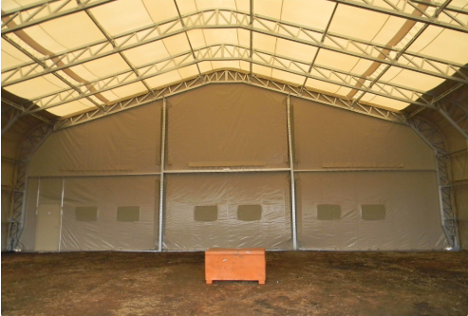
CAMSS60EX Engineering and Design
Engineering calculations demonstrate shelter performance meets a wind load of 100 mph per ASCE 7-16
Engineering calculations demonstrate shelter performance meets a ground snow load of 20 psf per ASCE 7-16
For more information on our CAMSS60EX, click
www.camss.com/product/camss-60ex/

Slide 13
CAMSS60EX Shelter System Video

Slide 14
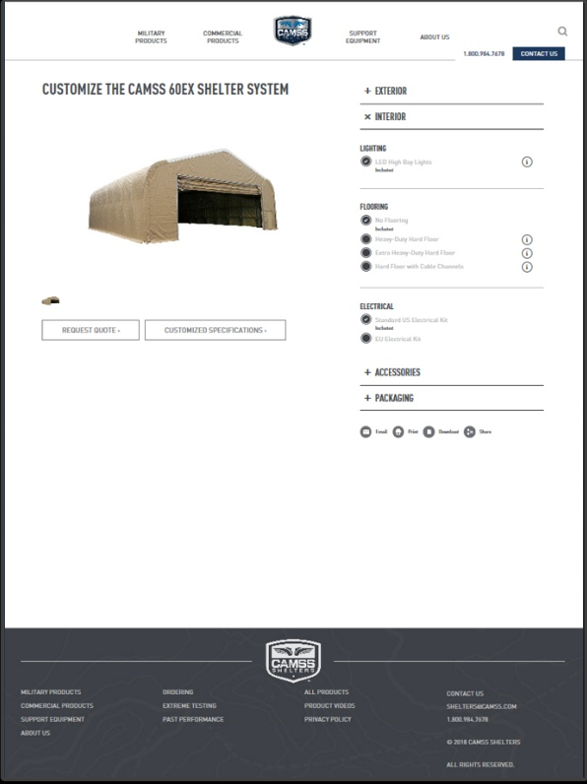
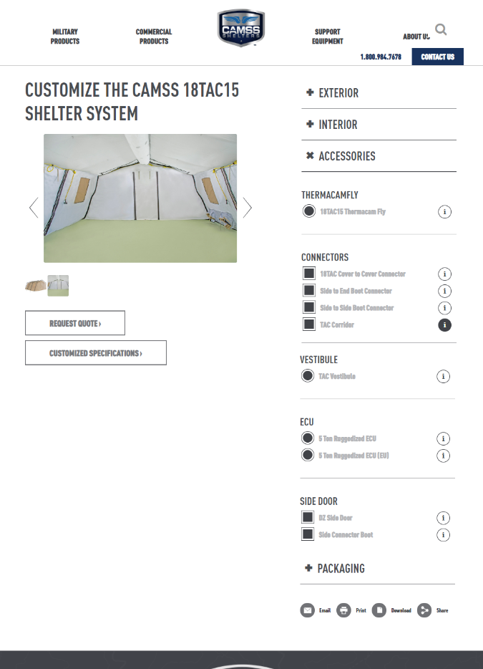
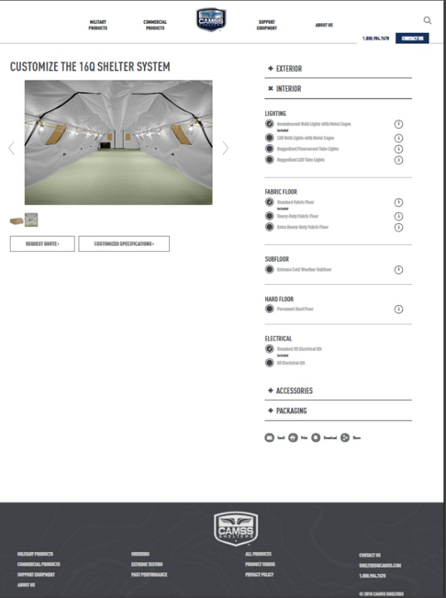
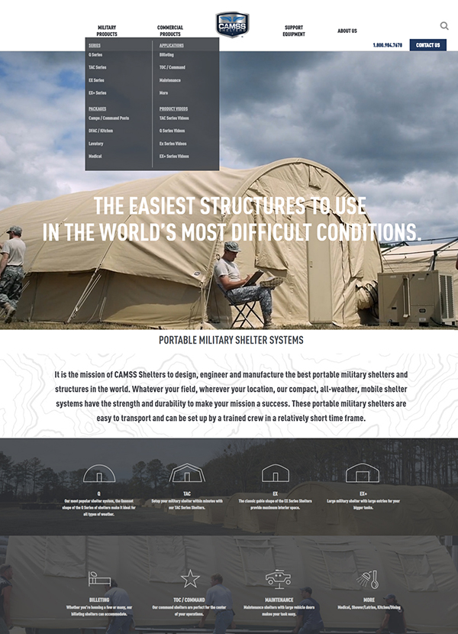
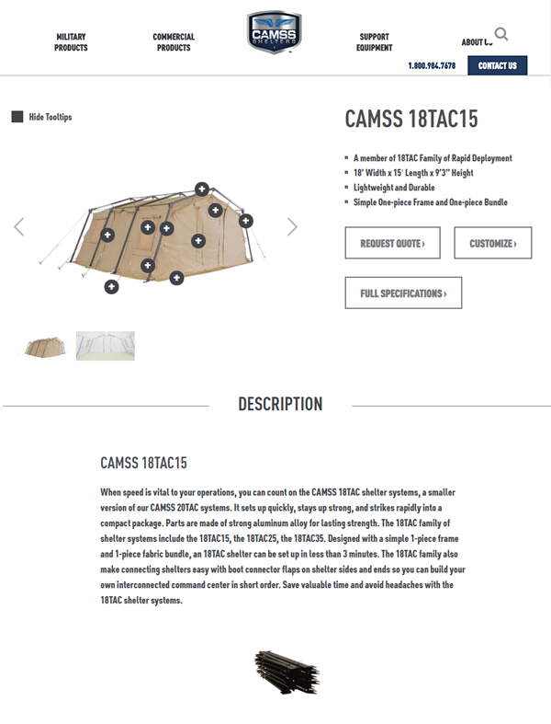
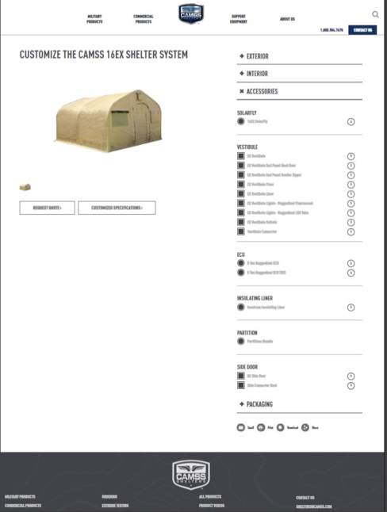
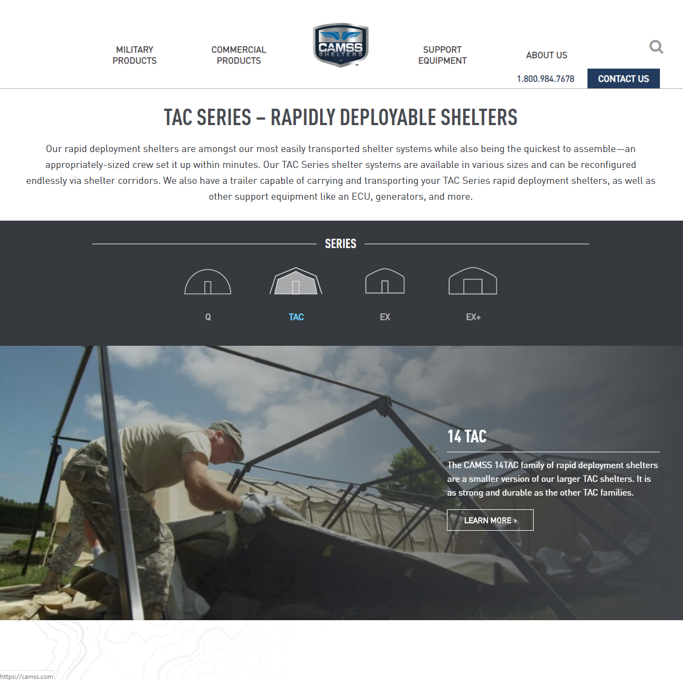
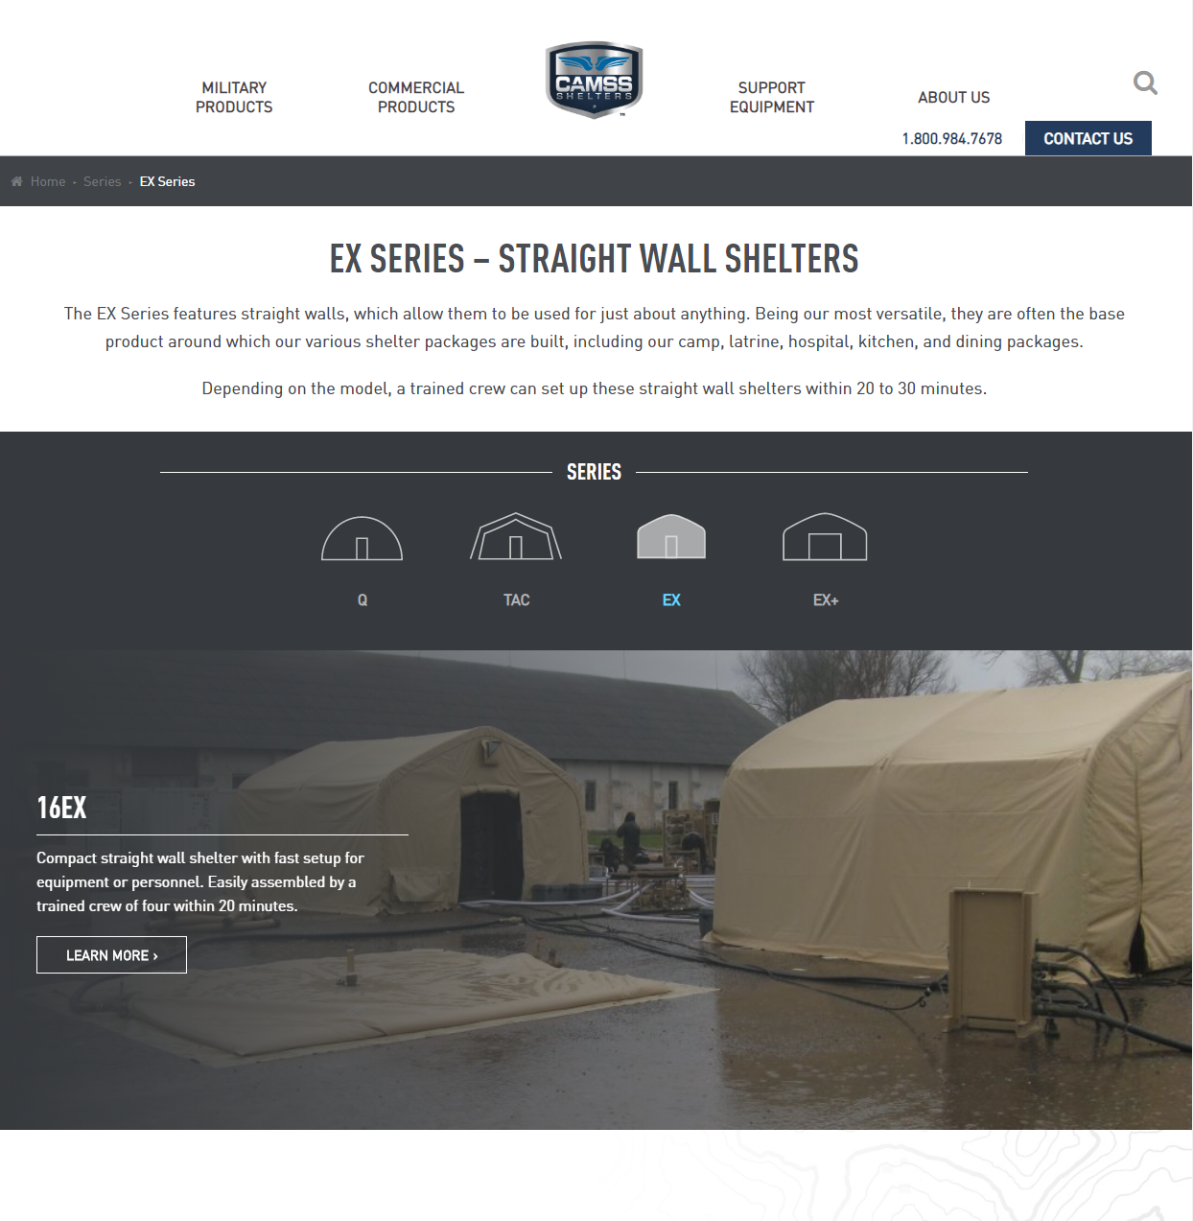
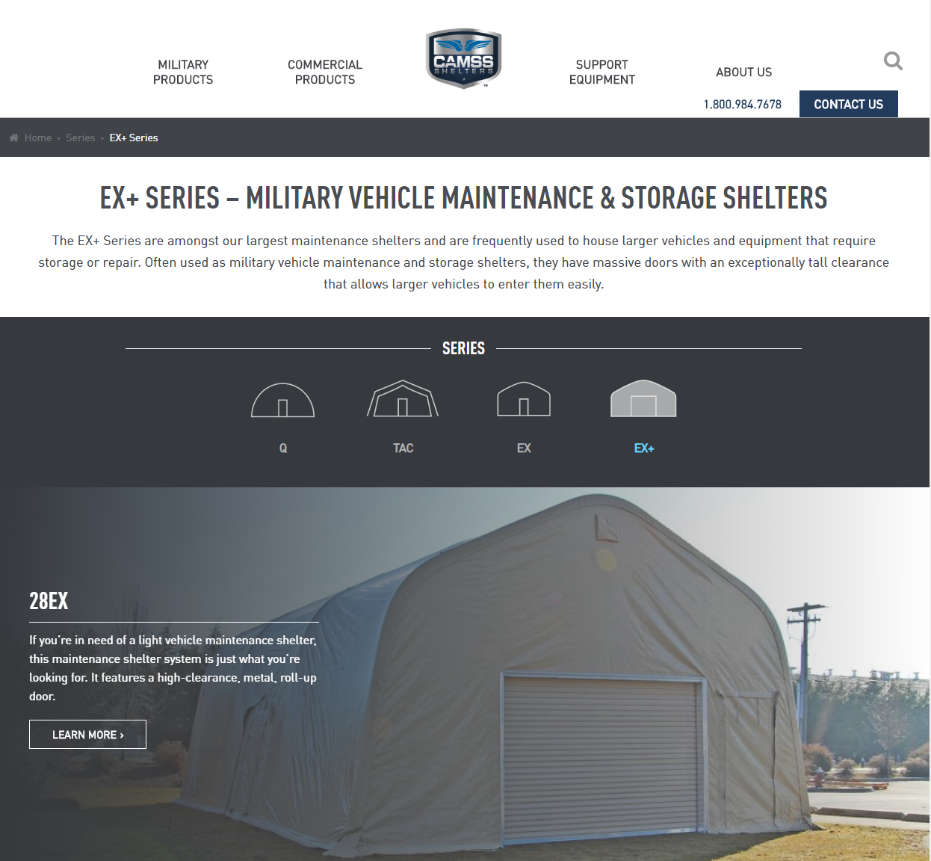
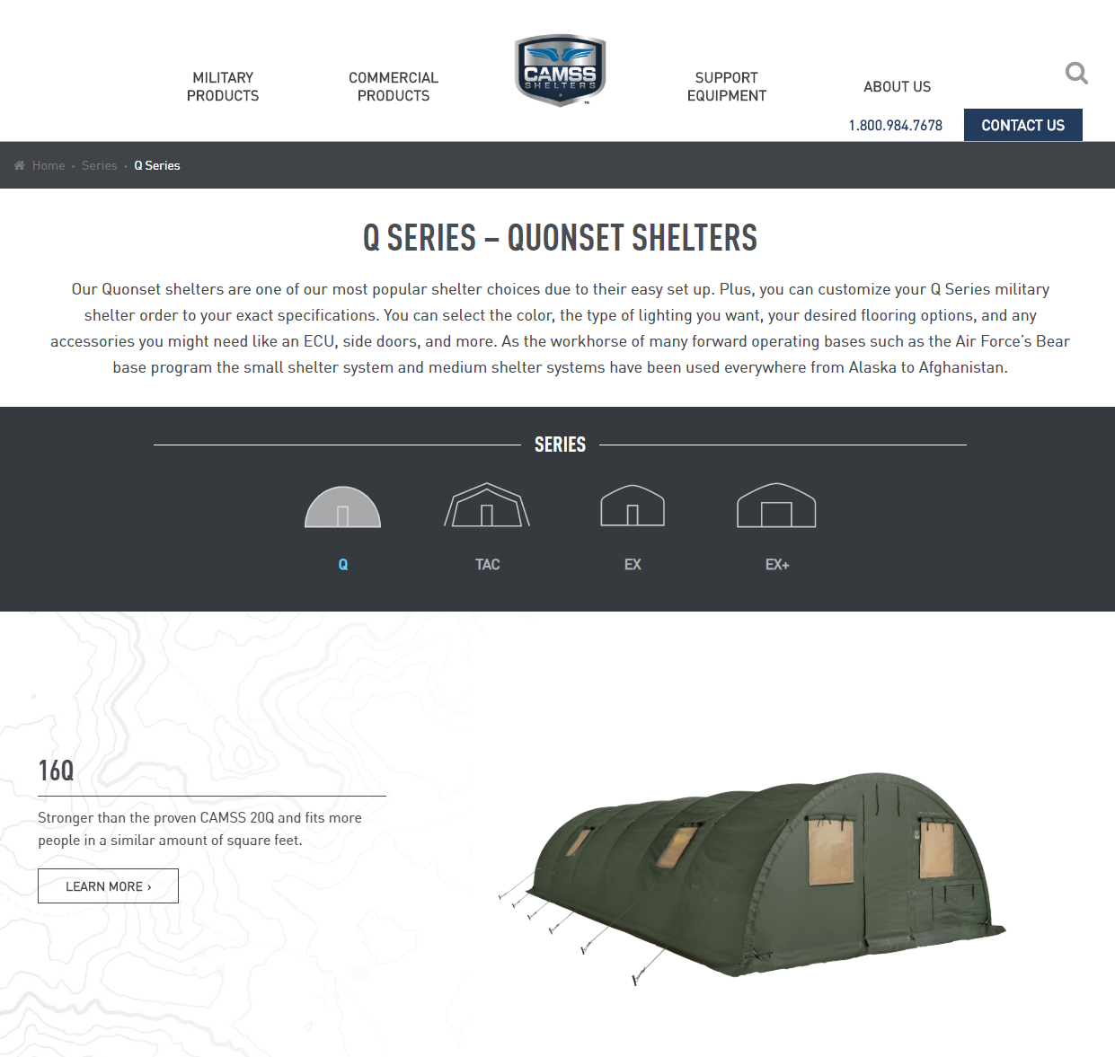
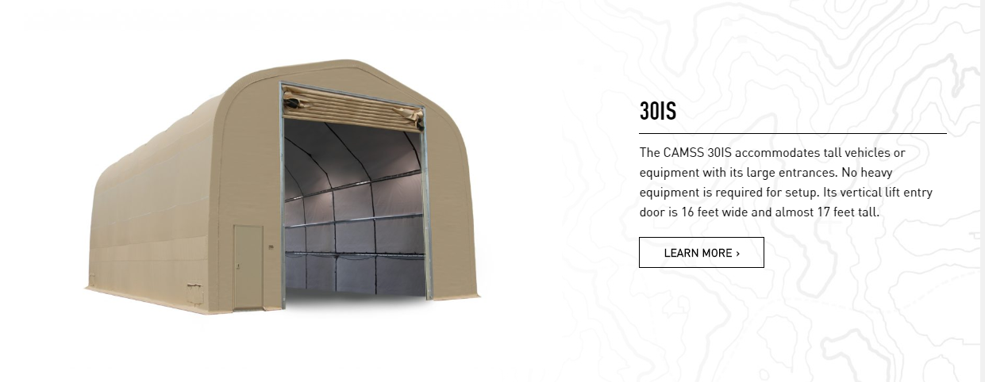
CAMSS Website
CAMSS.com
Product Page
Customize

Slide 15
Thank you for considering CAMSS Shelters
For further questions, please contact us below

