Slide 1
CAMSS EX Series
Straight Wall Shelter Systems

Slide 2
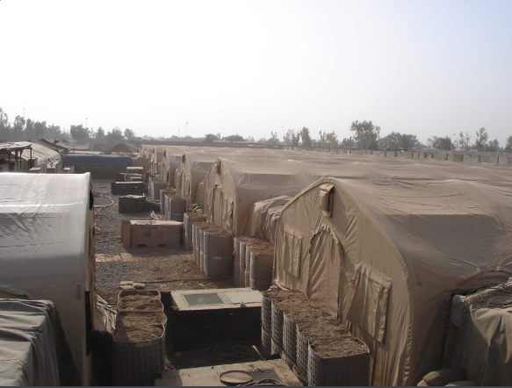
CAMSS Family of EX Shelter Systems
EX series features straight walls, allowing for equipment to be placed right up to the wall
Uses include kitchen equipment, bunk beds, I.V. stands, and many more
Trained crew can set up in as little as 20-30 minutes
Easy to complex end to end with optional side doors and corridors
Balad Theater Hospital
For more information on our EX shelters, click
https://camss.com/series/ex/

Slide 3
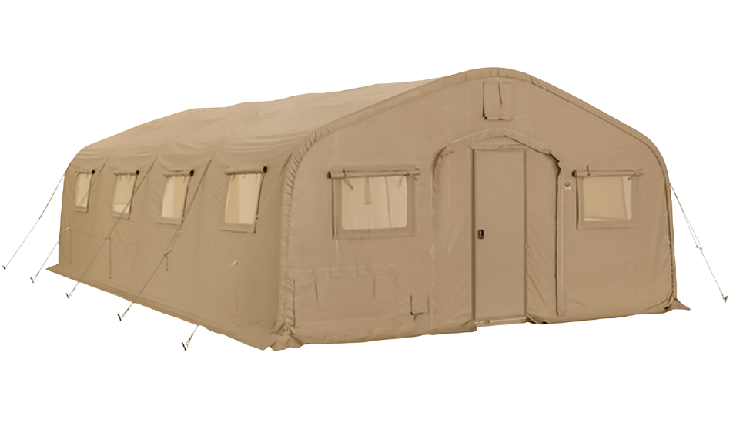
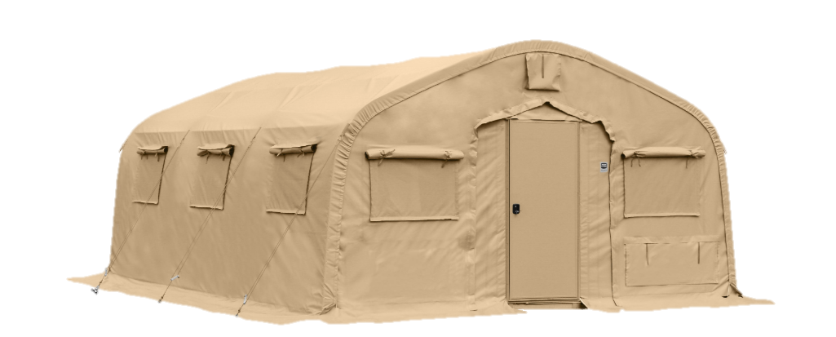
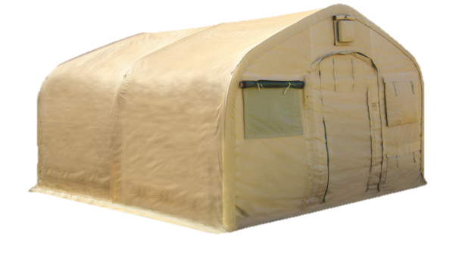
CAMSS EX Series Links
CAMSS 20EX
CAMSS 18EX
CAMSS 16EX

Slide 4
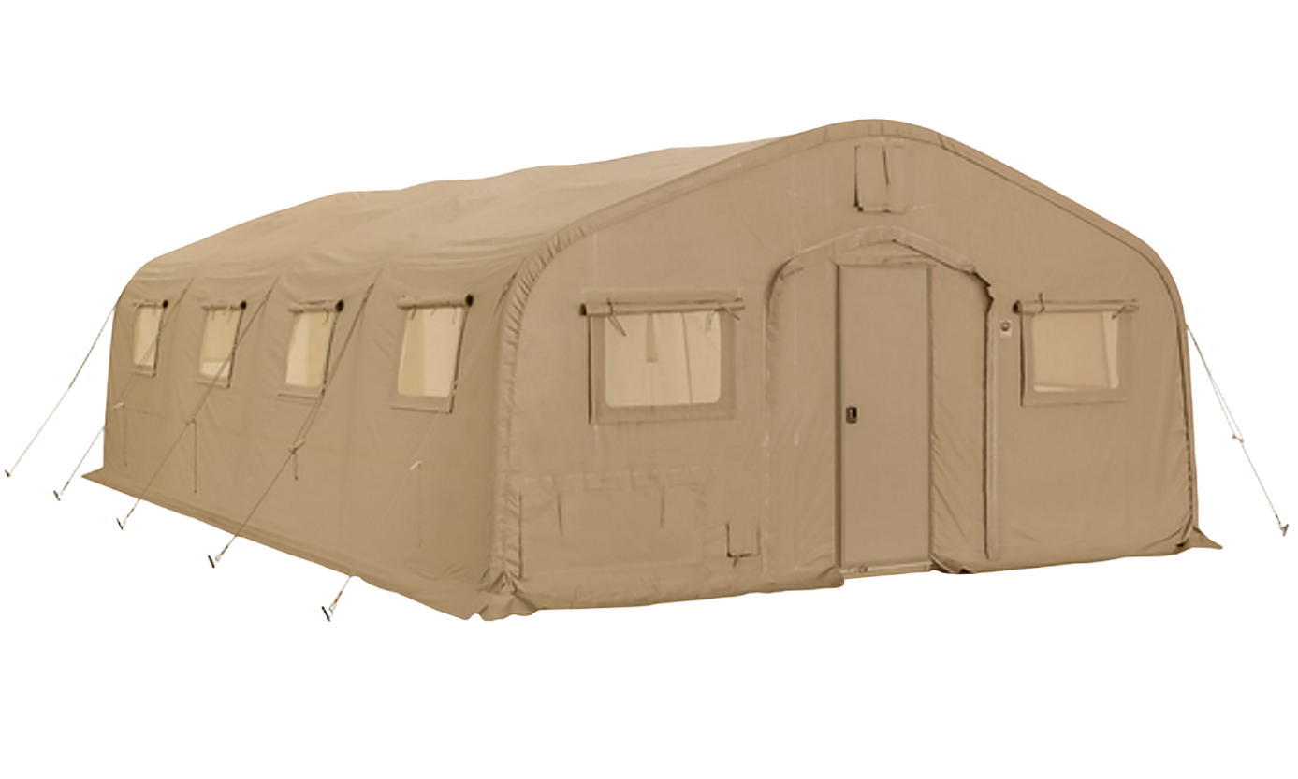
CAMSS20EX National Stock Number
NSN National Stock Number
Tan: 8340-01-568-9886
NSN National Stock Number
Green: 8340-01-568-9891
For more information on our EX shelters, click
https://camss.com/series/ex/

Slide 5
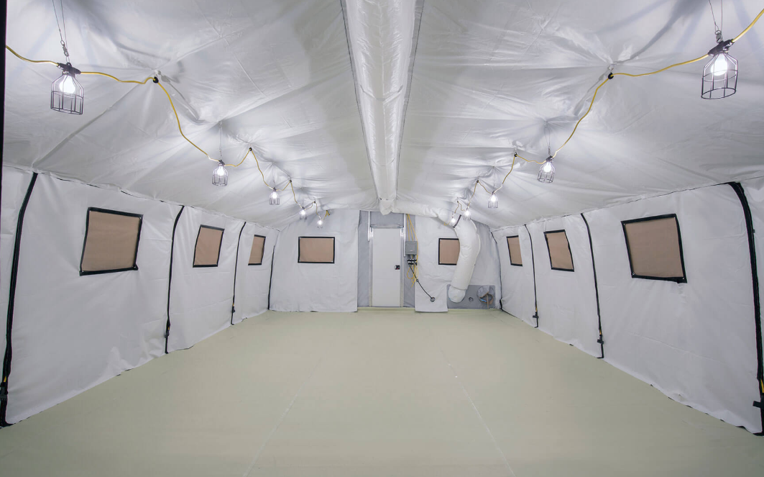
CAMSS20EX Engineering & Design
Designed to maintain internal temperatures of 40°F to 80°F in ambient temperature of -25°F to 125°F when supported by a 5-ton military environmental control unit.
Meets Test Operations Procedure (TOP) 10-2-175 Tents and Shelters wind load test of 55 mph sustained winds and 65 mph wind gusts
Engineered to withstand 100 mph winds per ASCE 7-16
CAMSS20EX Interior
For more information on our CAMSS20EX, click
www.camss.com/product/camss-20ex/

Slide 6
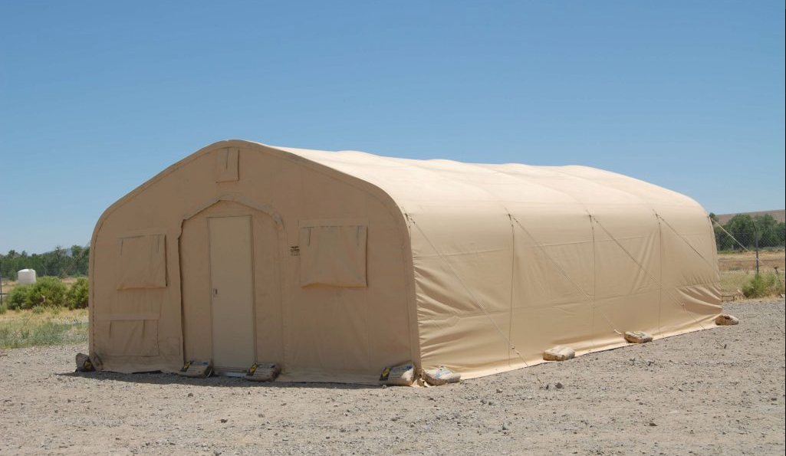
CAMSS20EX Engineering & Design
Meets Test Operations Procedure (TOP) 10-2-175 Tents and Shelters 10 psf snow load test per independent test.
Engineered to withstand 20 psf ground snow load per ASCE 7-16.
Meets blackout test per independent testing of similar type and size shelter (Test performed on CAMSS18RD)
20 Set-up/Strikes durability and be fully deployable per independent testing
For more information on our CAMSS20EX, click
www.camss.com/product/camss-20ex/

Slide 7
CAMSS18EX Part Numbers
Tan Part Number: CAMSS18EX24T
Green Part Number: CAMSS18EX24G
For more information on our EX shelters, click
https://camss.com/product/camss-18ex/

Slide 8
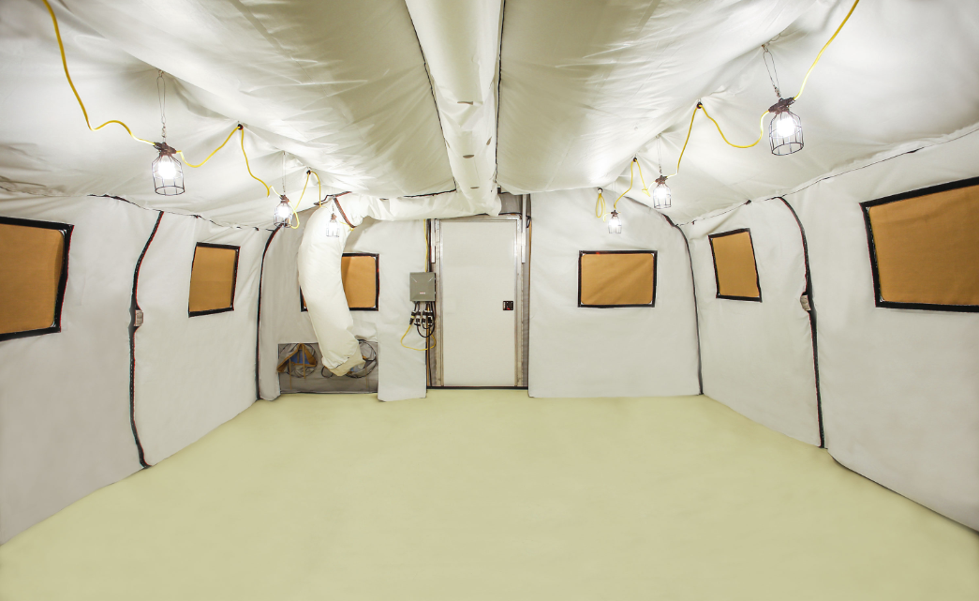
CAMSS18EX Engineering and Design
Designed to maintain internal temperatures of 40°F to 80°F in ambient temperatures of -25°F to 125°F with a 5-ton ECU
Engineered to withstand 100 mph wind load per ASCE 7-16
Engineered to withstand 15 psf ground snow load per ASCE 7-16
Designed for 20 set-up/strikes and fully deployable
For more information on our CAMSS18EX, click
http://www.camss.com/product/camss-18ex/

Slide 9
CAMSS16EX Part Numbers
Tan Part Number: CAMSS-16EX16T
Green Part Number: CAMSS-16EX16G
For more information on our EX shelters, click
https://camss.com/product/camss-16ex/

Slide 10
CAMSS16EX Engineering & Design
Designed to maintain internal temperatures of 40°F to 80°F in ambient temperatures of -25°F to 125°F when supported by a 5-ton military environmental control unit
Engineered to withstand 100 mph wind load per ASCE 7-16
Engineered to withstand 15 psf ground snow load per ASCE 7-16
Designed for 20 set-up/strikes and be fully deployable
For more information on our CAMSS16EX, click
www.camss.com/product/camss-16ex/

Slide 11
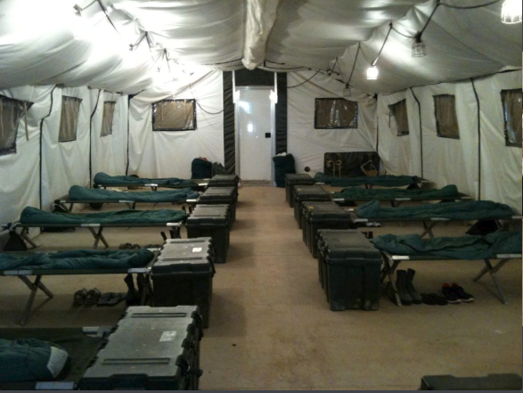
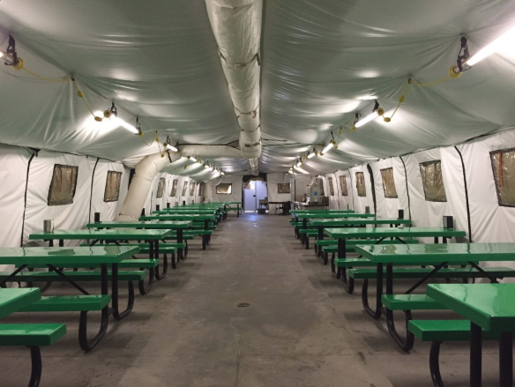
CAMSS EX Series Uses
Billeting
Dining

Slide 12
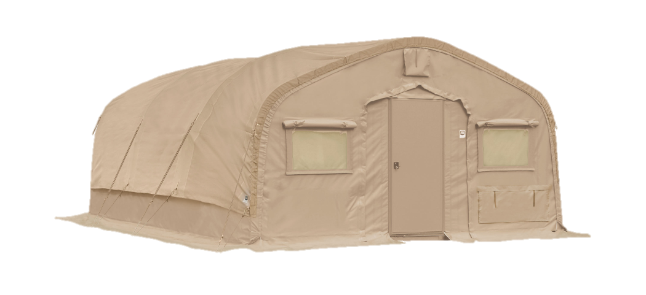
OPTIONAL: CAMSS EX Series SolarFlys
Significantly reduces heat from sun
Lightweight and compact
Designed to install without any disassembly of the shelter
RF welded mil-spec fabric with mesh that meets fire rating ASTM D6413
Uses shelter frame
Withstands 55 mph sustained winds with 65 mph wind gusts
20EX SolarFly
For more information on our flys, click
https://camss.com/support-equipment/flys/
18EX SolarFly

Slide 13
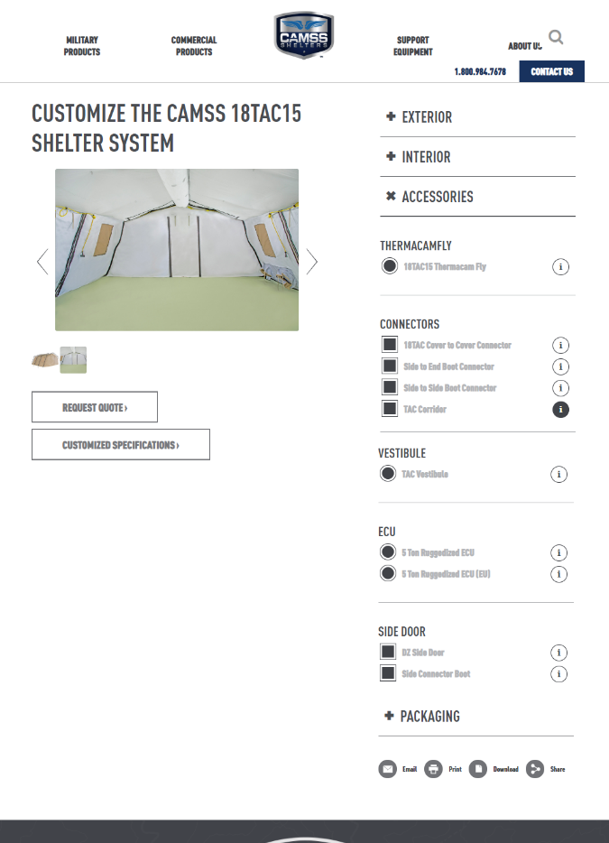
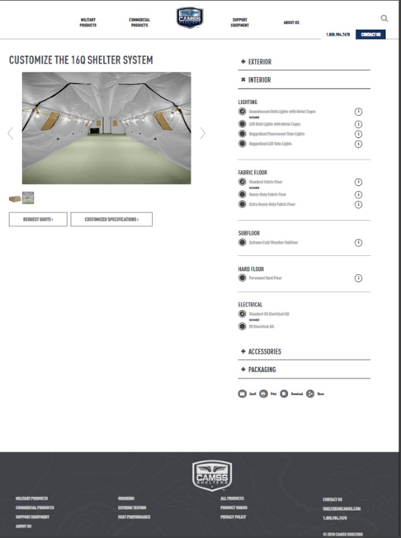
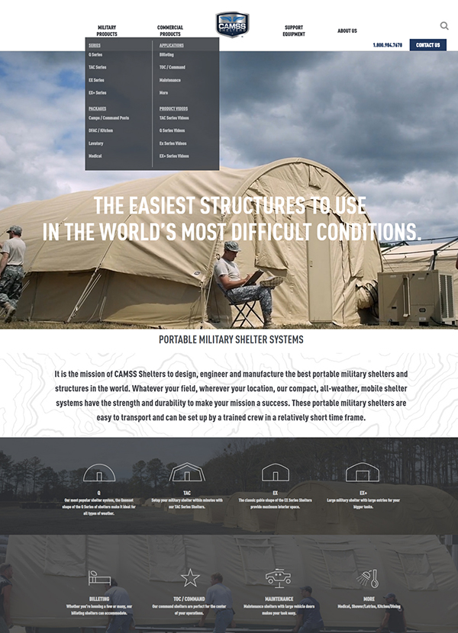
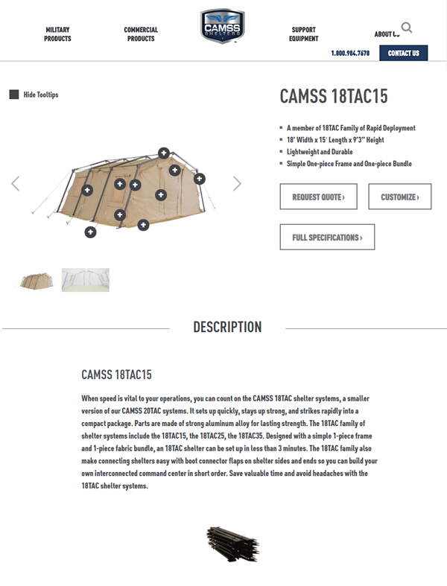
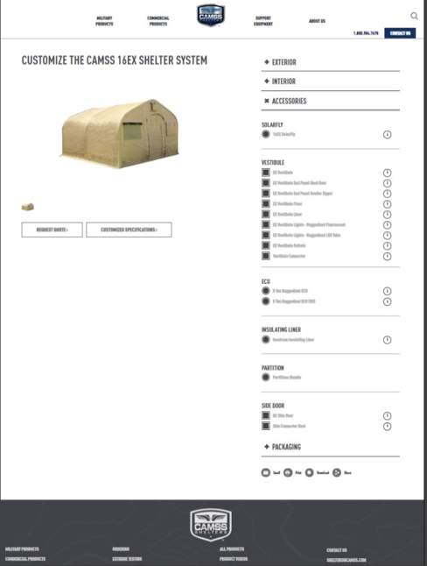
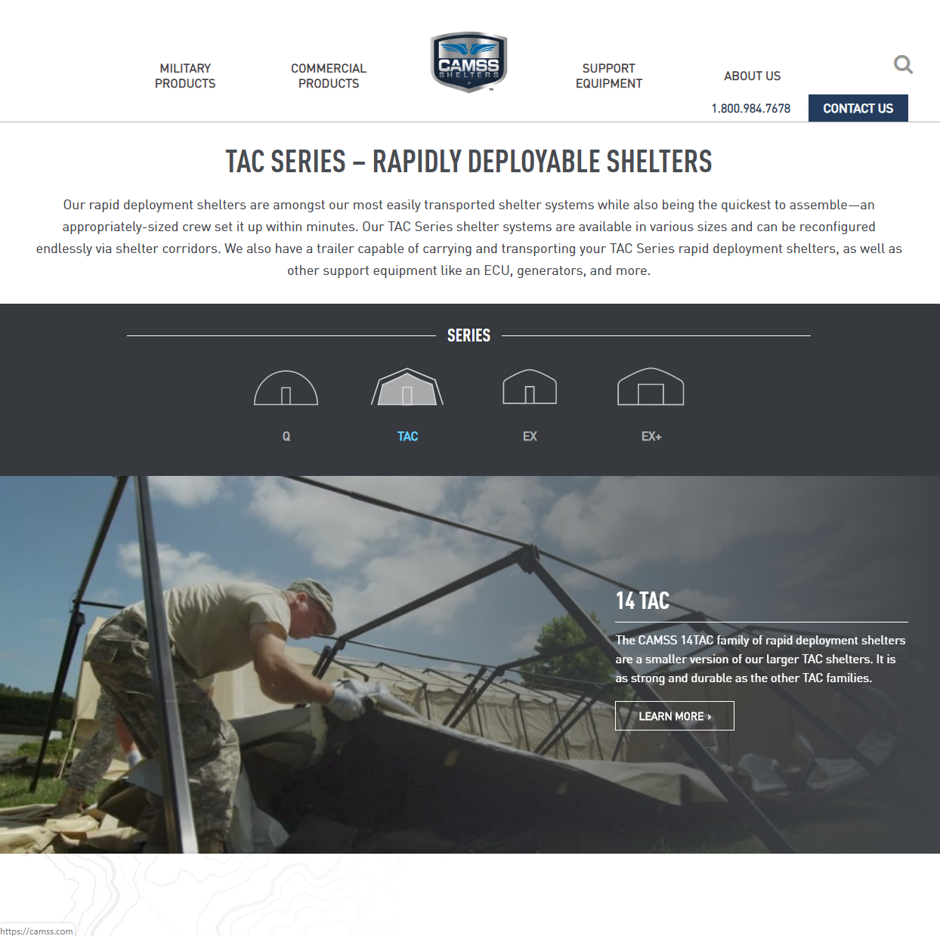
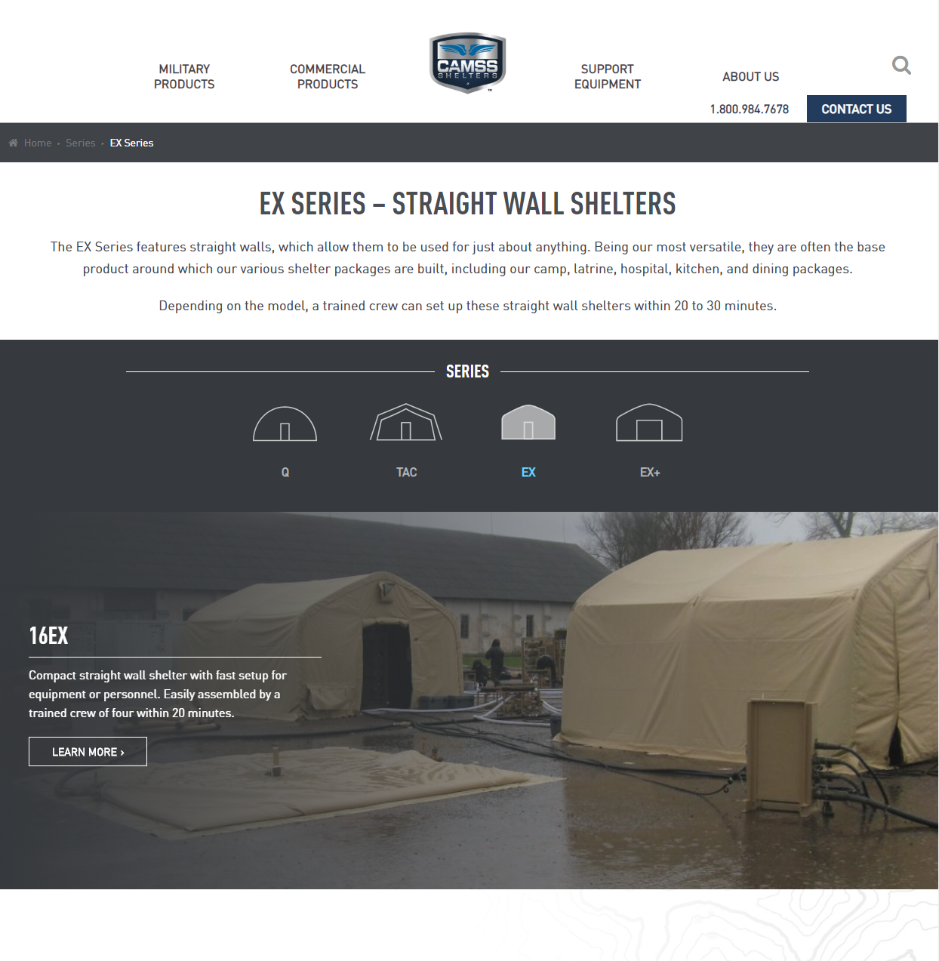
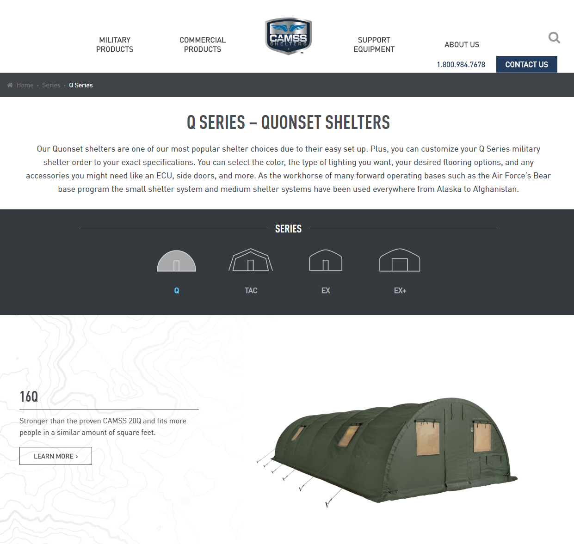
CAMSS Website
CAMSS.com
Product Page
Customize

Slide 14
Thank you for considering CAMSS Shelters
For further questions, please contact us below

