Slide 1
CAMSS Q Series
Shelter Systems
CAMSS TAC
Shelter Systems

Slide 2
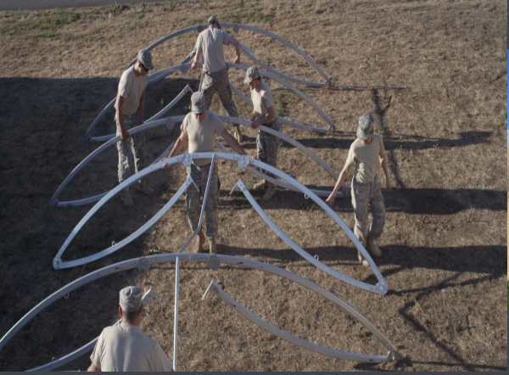
CAMSS Family of Quonset Shelter Systems
One of our most popular shelters due to easy set up and durability
Fully customizable to meet exact specification needs
Accessories available include environmental control units (ECU’s), ruggedized lighting, solar flys, and much more
CAMSS20QE Folding Frame
For more information on our Q shelters, click
https://camss.com/series/q/

Slide 3
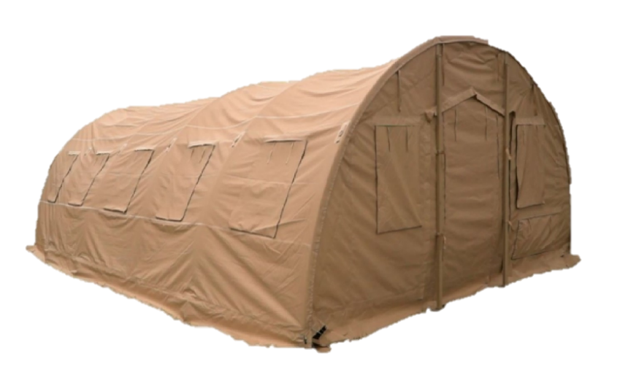
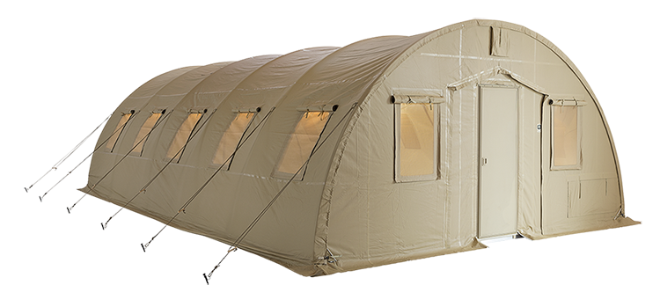
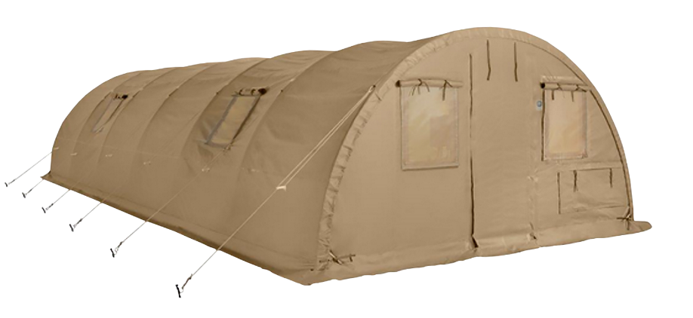
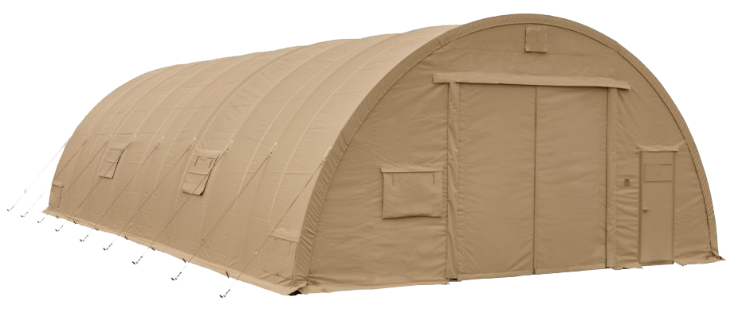
CAMSS Q Series Links
CAMSS 20QE
Rapid Deployment
Small Shelter System (RDSSS)
CAMSS 20Q
Small Shelter System (SSS)
CAMSS 30
U.S. Air Force
Medium Shelter System (MSS)
CAMSS 16Q

Slide 4
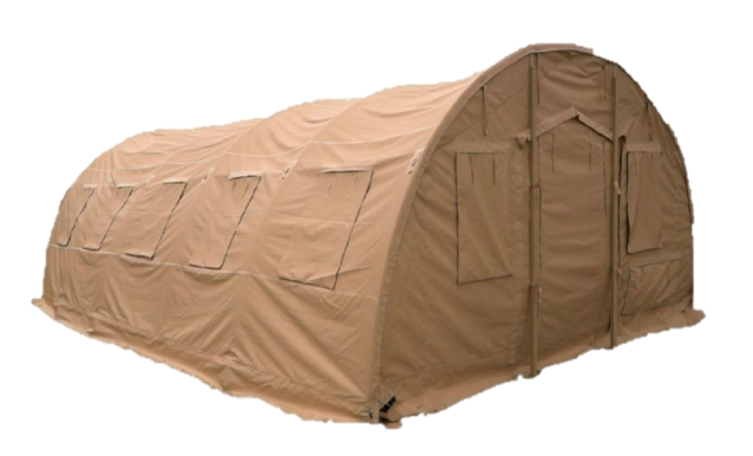
CAMSS20QE Rapid Deployment
Small Shelter System (RDSSS)
Tan Part Number
CAMSS-20QET
Green Part Number:
CAMSS-20QEG
For more information on our 20QE shelter, click
https://camss.com/product/camss-20qe/

Slide 5
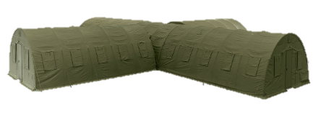
CAMSS20QE Testing & Engineering
Designed to maintain internal temperature of 40°F to 80°F in ambient temperature of -25°F to 125°F when supported by a 5-ton military environmental control unit.
Wind tested to 80 mph confirmed by test report
Engineering calculations demonstrate shelter performance meets a 100 mph wind load per ASCE 7-16.
Engineering calculation demonstrate shelter performance meets a 20 psf ground snow load per ASCE 7-16.
Tested for 50 Set-Up/Strikes and still be fully deployable

Slide 6
CAMSS20Q Small Shelter System (SSS)
NSN National Stock Number
Tan: 8340-01-568-9432
NSN National Stock Number
Green: 8340-01-570-9235
For more information on our Q shelters, click
https://camss.com/series/q/

Slide 7
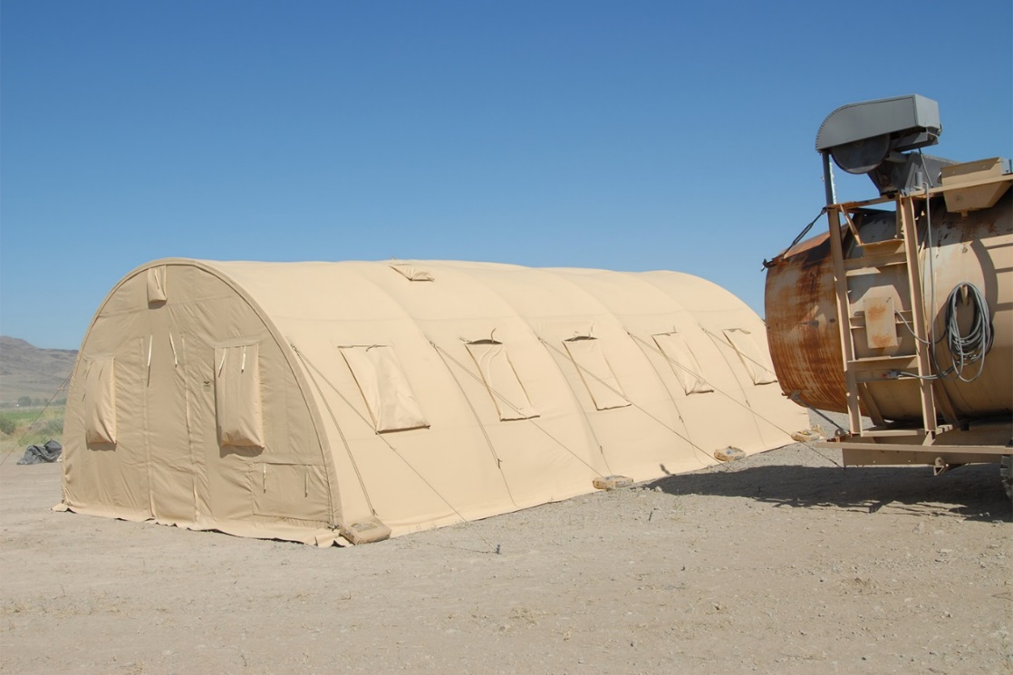
CAMSS20Q Extreme Testing and Engineering
Designed to maintain internal temperatures of 40°F to 80°F in ambient temperature of -25°F to 125°F when supported by a 5-ton military environmental control unit
Wind load capability per S.S.S. ORD
Engineering calculation demonstrate shelter performance will meet a 100 mph wind load per ASCE 7-16
Meets Test Operations Procedure (TOP) 10-2-175 Tents and Shelters snow load test of same type shelter in shorter length
Wind testing

Slide 8
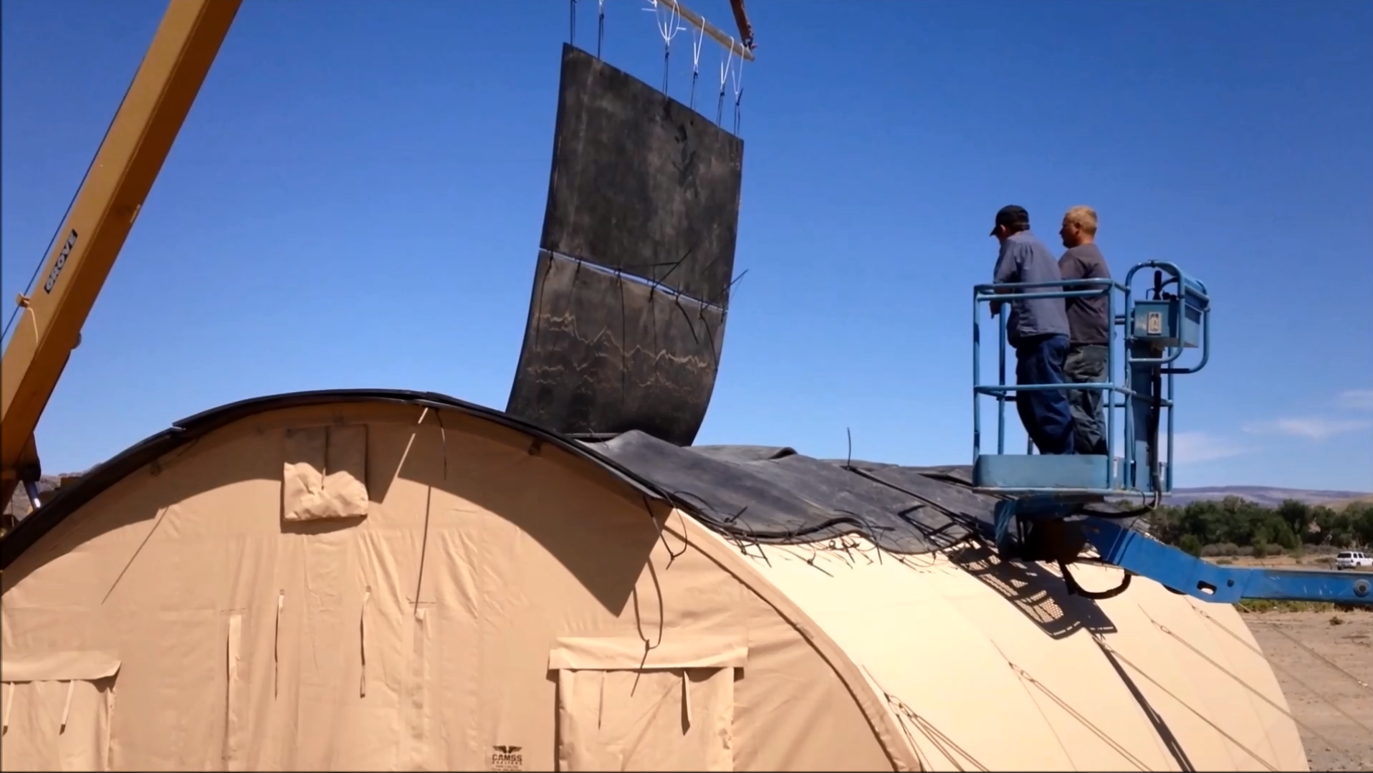
CAMSS20Q Extreme Testing and Engineering
Engineering calculations demonstrate shelter performance will meet a 20 psf ground snow load per ASCE 7-16
Meets Test Operations Procedure (TOP) 10-2-175 Tents and Shelters blowing rain test
Meets Test Operations Procedure (TOP) 10-2-175 Tents and Shelters blackout test at a minimum distance of 100 meters with the naked eye
Meets Test Operations Procedure (TOP) 10-2-175 Tents and Shelters blackout test at a minimum distance of 300 meters with night vision goggles
Meets 20 Set-up/Strikes cycles of durability testing per U.S. government test
CAMSS20Q snow load testing

Slide 9
CAMSS30 Medium Shelter System – U.S. Air Force
NSN National Stock Number
Tan: 5419-01-465-3019
NSN National Stock Number
Green: 5419-01-465-3023
For more information on our Q shelters, click
https://camss.com/series/q/

Slide 10
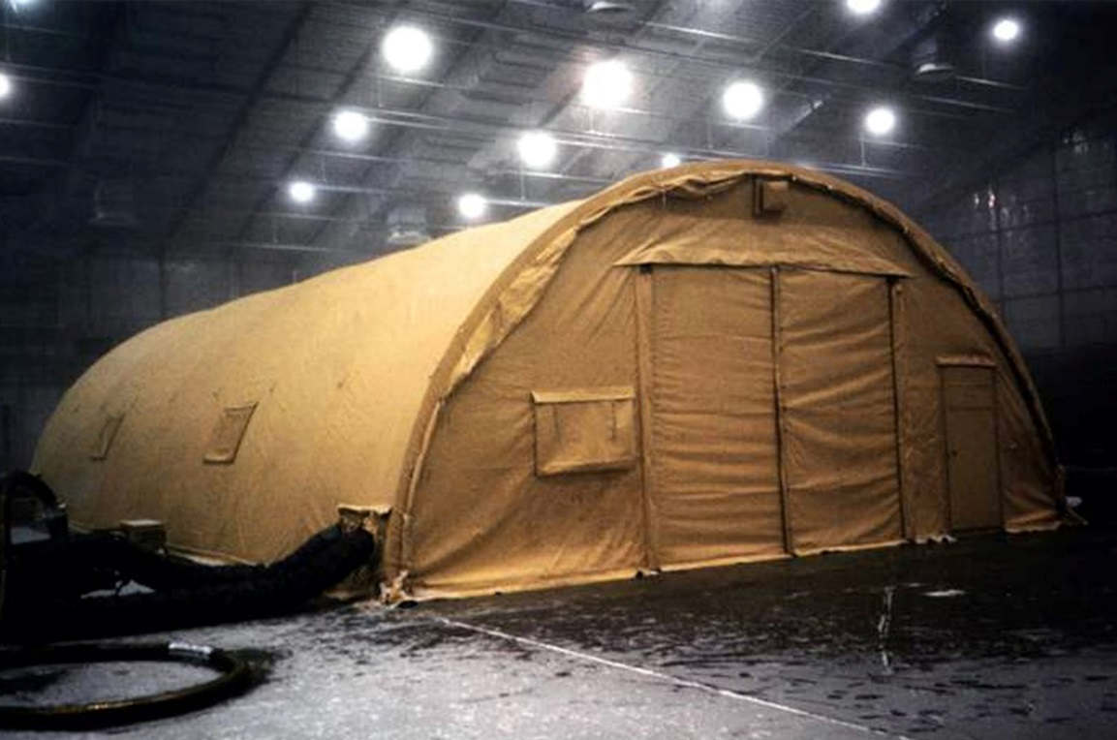
CAMSS30 Extreme Testing
Tested from -50° to 125° F to maintain inside temperatures of 40° to 80° F with standard military 5-ton ECUs. High heat test conducted with full simulated Saudi Arabia solar load. (Source Selection Testing – McKinley Climatic Laboratories)
Wind load tested to 55 mph sustained and 65 mph wind gusts to meet Medium Shelter ORD per U.S. Air Force Source Selection (Aberdeen Proving Grounds)
Snow load capability of 20 psf (Source Selection Review)

Slide 11
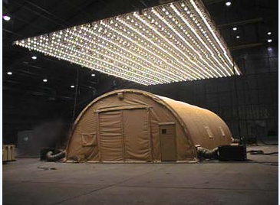
CAMSS30 Extreme Testing
Meets naked eye blackout test (Source Selection Testing)
20 setup/strikes and still mission capable (AFOTEC Testing)
Assembles in under two and one half hours (150 minutes) with trained crew of six (AFOTEC Testing)
Tested and passed rain test 40 mph wind with rate of 5 inches per hour (Source Selection Testing – Aberdeen Proving Ground)
Tested to assemble in MOPP-2 and cold weather gear (AFOTEC Testing)
CAMSS30 Extreme Testing

Slide 12
CAMSS16Q Shelter System
Tan Part Number
CAMSS-HIT-16Q39T
Green Part Number:
CAMSS-HIT-16Q39G
For more information on our 16Q shelter, click
https://camss.com/product/camss-16q/

Slide 13
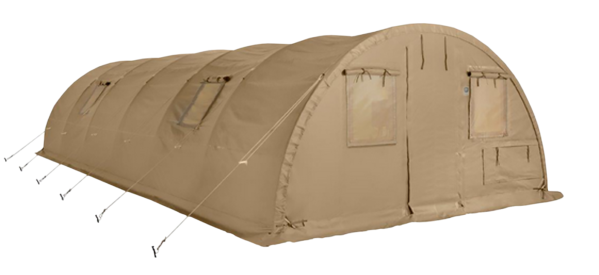
CAMSS16Q Testing & Engineering
Designed to maintain internal temperature of 40°F to 80°F in ambient temperature of -25°F to 125°F when supported by a 5-ton military environmental control unit
Meets test operations procedure (TOP) 10-2-175 tents and shelters wind load test of similar type and size shelter
Engineering calculations demonstrate shelter performance meets a 100 mph wind load per ASCE 7-16

Slide 14
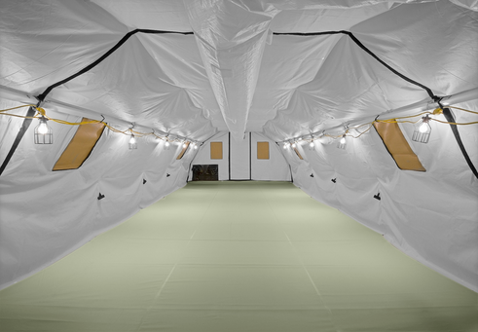
CAMSS16Q Testing & Engineering
Meets test operations procedure (TOP) 10-2-175 tests and shelters snow load test of similar type and size shelter
Engineering calculations with quote of this shelter demonstrating shelter performance meets a 20 psf ground snow load per ASCE 7-16
20 set-up/strikes and be fully deployable

Slide 15
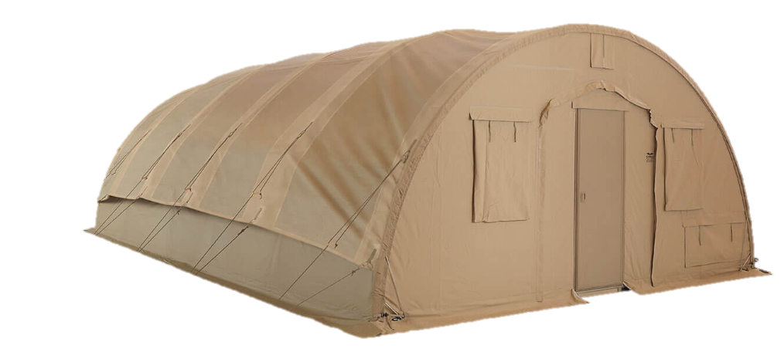
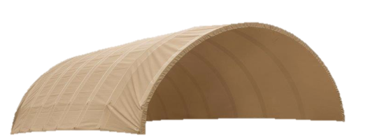
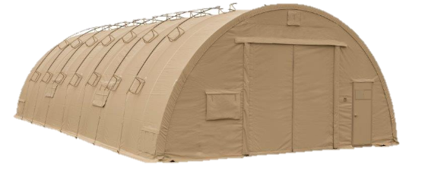
OPTIONAL: CAMSS Q Series SolarFlys
Significantly reduces heat from sun
Lightweight and compact
Designed to install without any disassembly of the shelter
RF welded mil-spec fabric with mesh that meets fire rating ASTM D6413
Uses shelter frame
Withstands 55 mph sustained winds with 65 mph wind gusts
CAMSS20Q SolarFly
For more information on our flys, click
https://camss.com/support-equipment/flys/
CAMSS30 SolarFly

Slide 16
CAMSS20QE Shelter Timed Setup Test Video

Slide 17
CAMSS30 Shelter System Video

Slide 18
CAMSS20Q Small Shelter Testing Video

Slide 19
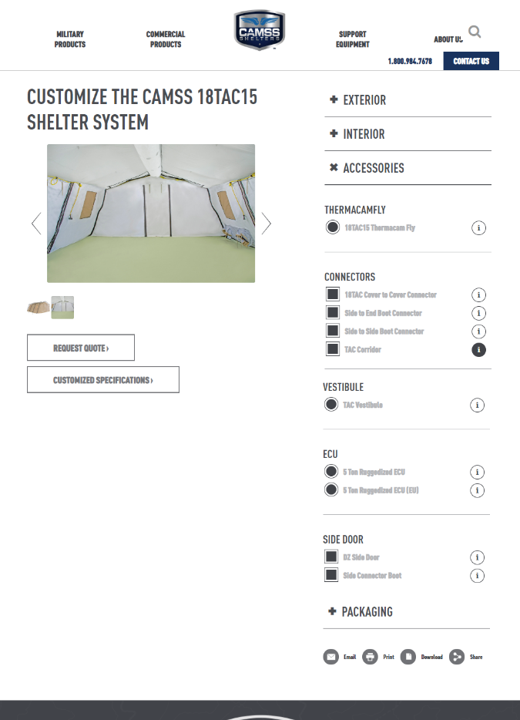
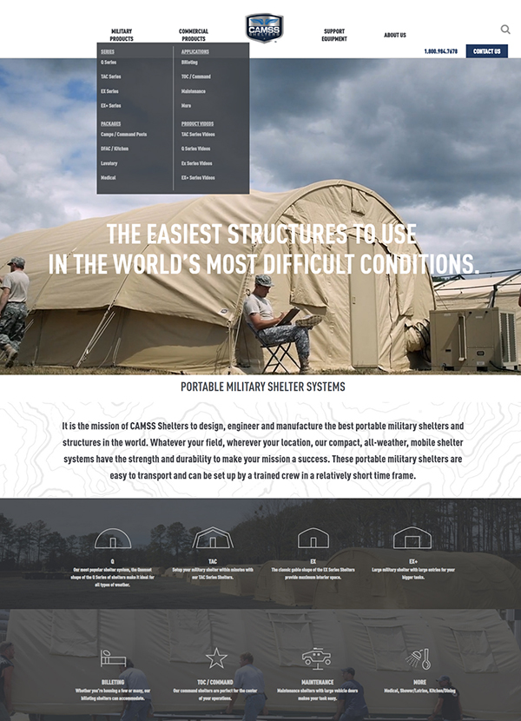
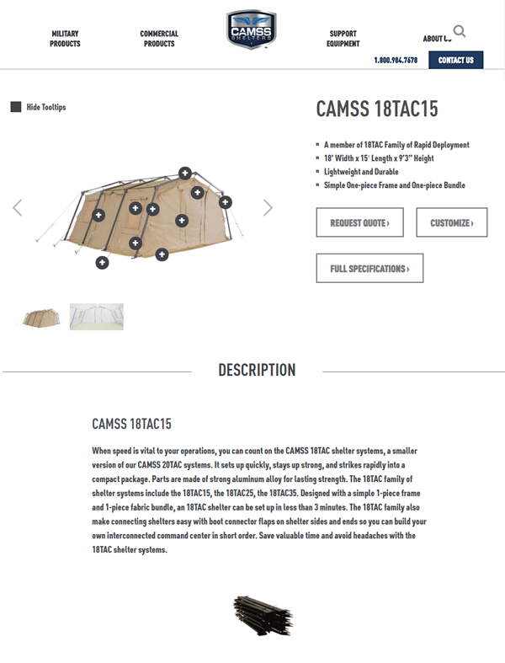
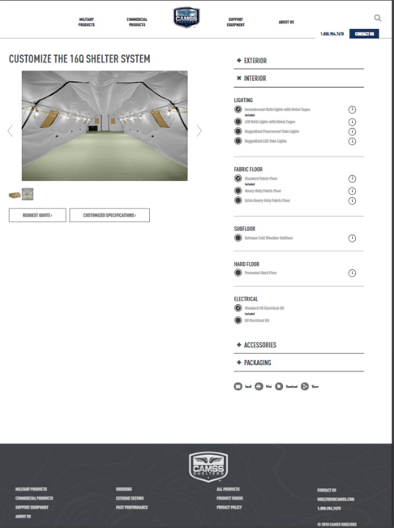
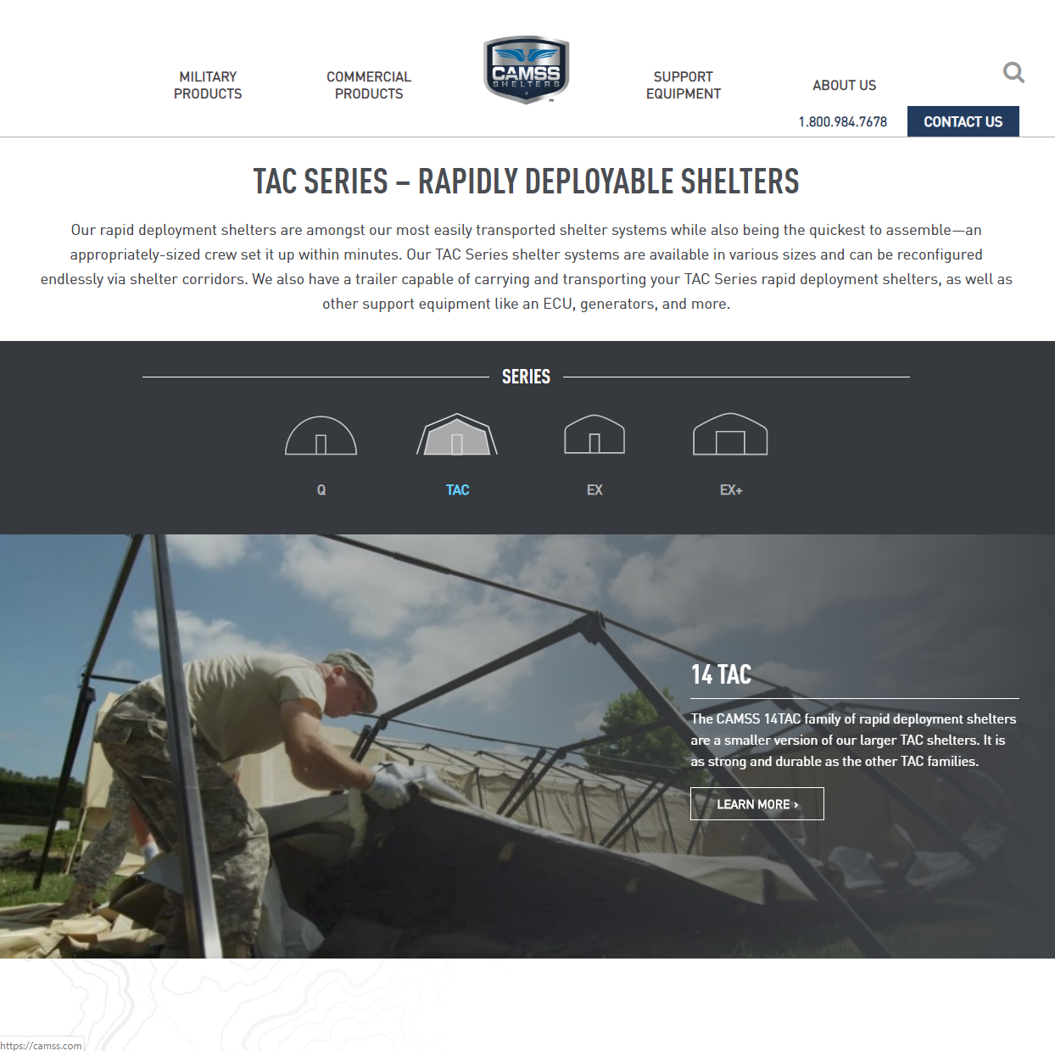
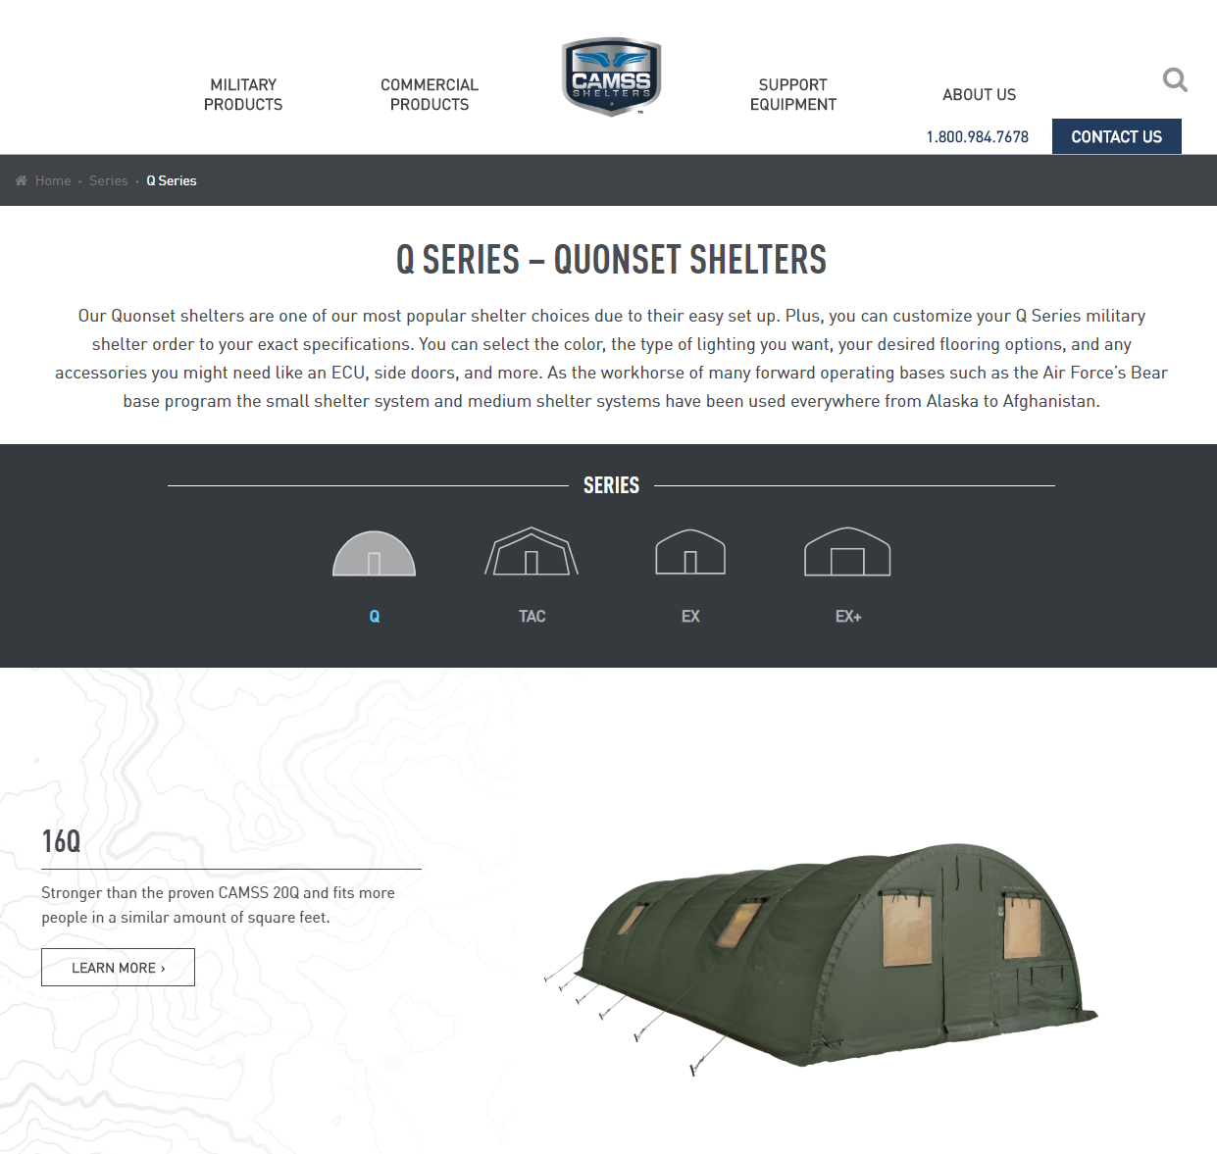
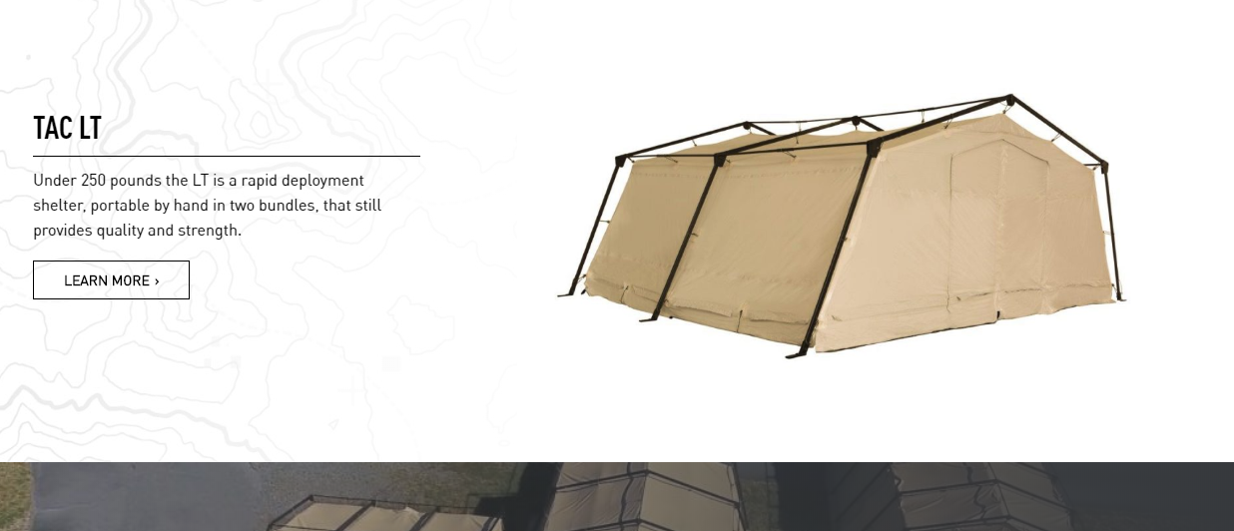
CAMSS Website
CAMSS.com
Product Page
Customize

Slide 20
Thank you for considering CAMSS Shelters
For further questions, please contact us below

